Slide 1


SparQL
Querying semantic data

Slide 2
Introduction
Overview of the Semantic Web
How interrelated datasets (linked data) work
Triples vs relations (tables)
Semantic Web Standards
RDF, OWL etc.
SPARQL Syntax
SELECT, WHERE, LIMIT, variables, etc.
Shortcuts, graphs, and unions
Querying a Semantic Website
Accessing a SPARQL Endpoint
Querying a dataset
Advanced SPARQL Constructs
FILTER, OPTIONAL, etc.
Modelling Semantic Data
URI, URL, URN, Namespace, etc.
Semantic Web standards (RDF, OWL, etc.)
Integrating SPARQL into an Application
Java libraries (Jena, etc.)
Transitioning a Website into a Semantic Web Website
Converting data into semantic data
Troubleshooting
Summary and Conclusion
Ajay Singhal : Skype: aksing1711

Slide 3
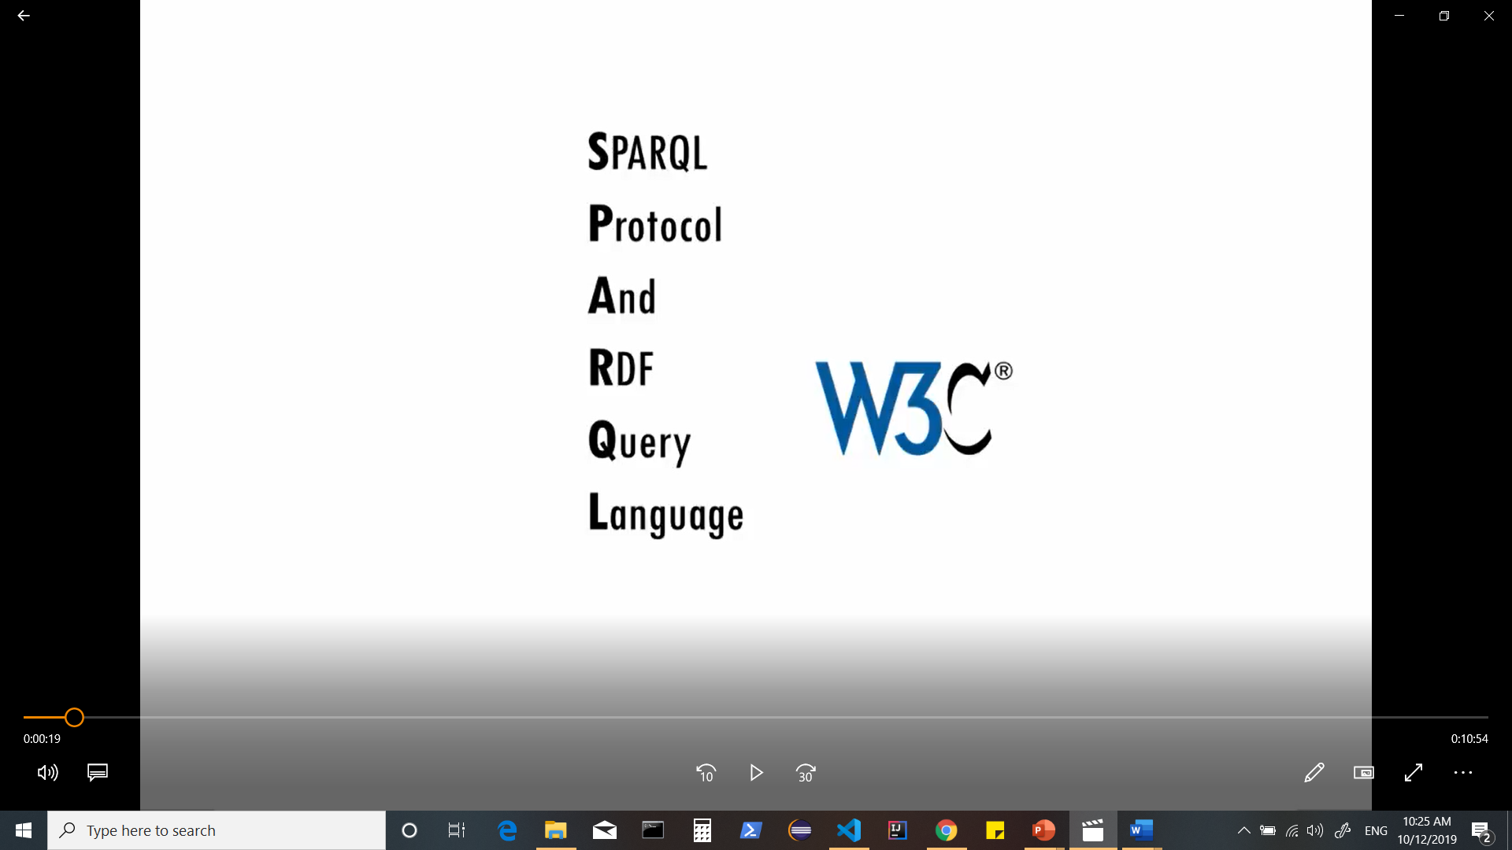
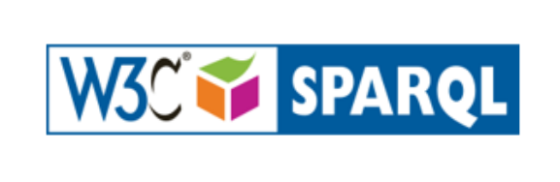
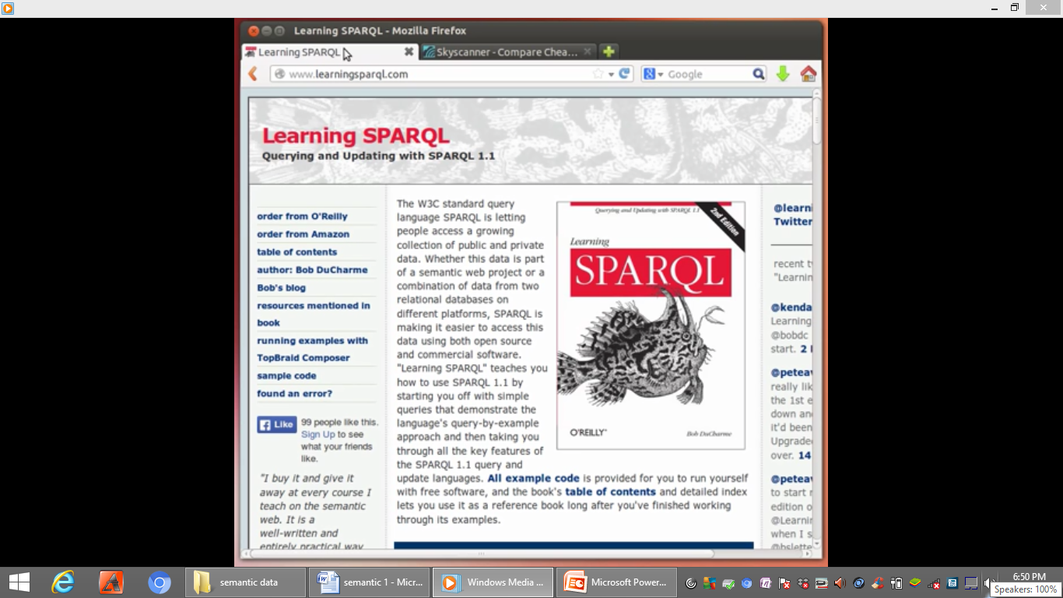
Notes:
Sparql is a w3c standard it stands for Sparql protocol and RDF query language.
the protocol part is usually only an issue for people writing programs that pass sparql queries back and forth between different machines ,for most people sparkql’s greatest value is as a
query language for rdf (resource description framework) another w3c standard.

Slide 4
Semantic Web
A set of standards and best practices for sharing data and the semantics of that data over the web for use by applications.
W3C’s vision of the Web of linked data. Semantic Web technologies enable people to create data stores on the Web, build vocabularies, and write rules for handling data.

Slide 5
The Semantic Web is a Web of data — of dates , titles , part numbers , chemical properties and any other data.
RDF provides the foundation for publishing and linking your data.
Various technologies allow you to embed data in documents or expose what you have in SQL databases, or make it available as RDF files.

Slide 6
Collection of Semantic web technologies, provide an environment where application can query the data, draw inferences using Vocabularies etc.
RDF
OWL
SKOS
SPARQL

Slide 7
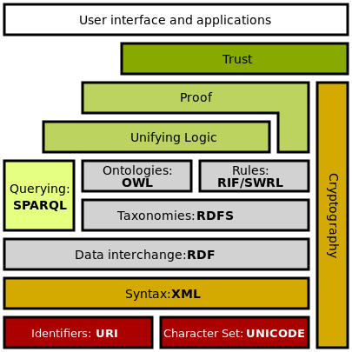
The collection, structuring and recovery of linked data are enabled by technologies that provide a formal description of concepts, terms, and relationships within a given knowledge domain. These technologies are specified as W3C standards.
The Semantic Web Stack illustrates the architecture of the Semantic Web.

Slide 8
Resource Description Framework (RDF), a general method for describing information
RDF Schema (RDFS)
Simple Knowledge Organization System (SKOS)
SPARQL, an RDF query language
Notation3 (N3), designed with human-readability in mind
N-Triples, a format for storing and transmitting data
Turtle (Terse RDF Triple Language)
Web Ontology Language (OWL), a family of knowledge representation languages
Rule Interchange Format (RIF), a framework of web rule language dialects supporting rule interchange on the Web

Slide 9
XML provides an elemental syntax for content structure within documents, yet associates no semantics with the meaning of the content contained within. Turtle is a de facto standard, but has not been through a formal standardization process.
XML Schema is a language for providing and restricting the structure and content of elements contained within XML documents.
RDF is a simple language for expressing data models, which refer to objects ("web resources”) and their relationships. An RDF-based model can be represented in a variety of syntaxes, e.g., RDF/XML, N3, Turtle, and RDFa. RDF is a fundamental standard of the Semantic Web.
RDF Schema extends RDF and is a vocabulary for describing properties and classes of RDF-based resources, with semantics for generalized-hierarchies of such properties and classes.
Notes:
XML is not at present a necessary component of Semantic Web technologies in most cases, as alternative syntaxes exists, such as Turtle.

Slide 10
OWL (Web Ontology Language) adds more vocabulary for describing properties and classes: among others, relations between classes (e.g. disjointness), cardinality (e.g. "exactly one"), equality, richer typing of properties, characteristics of properties (e.g. symmetry), and enumerated classes.
SPARQL is a protocol and query language for semantic web data sources.
RIF is the W3C Rule Interchange Format. It's an XML language for expressing Web rules that computers can execute. RIF provides multiple versions, called dialects. It includes a RIF Basic Logic Dialect (RIF-BLD) and RIF Production Rules Dialect (RIF PRD).

Slide 11
Linked Data

Slide 12
It is important to have the huge amount of data on the Web available in a standard format, reachable and manageable by Semantic Web tools.
Semantic Web need access to data & relationships among data should be made available, to create a Web of Data (as opposed to a sheer collection of datasets).
This collection of interrelated datasets on the Web can also be referred to as Linked Data.
Linked Data lies at the heart of what Semantic Web is all about: large scale integration of, and reasoning on, data on the Web.
Notes:
However, to make the Web of Data a reality, it is important to have the huge amount of data on the Web available in a standard format, reachable and manageable by Semantic Web tools. Furthermore, not only does the Semantic Web need access to data, but relationships among data should be made available, too, to create a Web of Data (as opposed to a sheer collection of datasets). This collection of interrelated datasets on the Web can also be referred to as Linked Data.
To achieve and create Linked Data, technologies should be available for a common format (RDF), to make either conversion or on-the-fly access to existing databases (relational, XML, HTML, etc). It is also important to be able to setup query endpoints to access that data more conveniently. W3C provides a palette of technologies (RDF, GRDDL, POWDER, RDFa, the upcoming R2RML, RIF, SPARQL) to get access to the data.
Linked Data lies at the heart of what Semantic Web is all about: large scale integration of, and reasoning on, data on the Web.

Slide 13
DBPedia : A large Linked Dataset
Notes:
Examples
A typical case of a large Linked Dataset is DBPedia which, essentially, makes the content of Wikipedia available in RDF. The importance of DBPedia is not only that it includes Wikipedia data, but also that it incorporates links to other datasets on the Web, e.g., to Geonames. By providing those extra links (in terms of RDF triples) applications may exploit the extra (and possibly more precise) knowledge from other datasets when developing an application; by virtue of integrating facts from several datasets, the application may provide a much better user experience.

Slide 14
Linked Data
It is about making links, so that a person or machine can explore the web of data. With linked data, when you have some of it, you can find other, related, data.
Think about HTML documents; when people started weaving these together with hyperlinks we got a Web of documents.
Now think about data; when people started weaving individual bits of data together with RDF triples (that expressed the relationship between these bits of data) we saw the emergence of a Web of data.
Linked Data is no more complex than this – connecting related data across the Web using URIs, HTTP and RDF.

Slide 15
Linked Data isn’t about rebranding the Semantic Web, it’s about clarifying its fundamentals.
Notes:
Tim Berners-Lee said several times last year, in public, that “Linked Data is the Semantic Web done right”

Slide 16
RDF : Resource Description Framework
RDF is a language for the representation of resources:
A Resource can be anything
Within the context of the Web, relevance is given to Web Resources .i.e. anything that can be located via a URL.
The basic building block is the statement (or triple)
One of the main applications : Data Integration
Notes:
RDF : Resource description framework to represent resources.
A resource can be anything a person a book a car a computer a machine planet Earth the Sun the Moon the Stars ,anything you can
think of can be a resource although in our context here we speak about web resources but in general it can be any
thing when we say web resources we mean for example anything that can be located by URL .
In RDF whenever we want to describe a resource the basic idea or the basic building block is to have a
statement of the form of a triple i.e. we can describe anything using one statement that has three parts that's
why it's called a triple. One nice idea behind using RDF or even using triples is that data integration becomes very easy.

Slide 17
RDF Overview
W3C Recommendation since 1998
RDF is also a Data Model.
Originally used for metadata for web resources, then generalized for other applications.
Universal, machine readable exchange format.
Data Structured in graphs (vertices, edges)
Notes:
As a recommendation from w3c it's a data model, it was originally used for metadata for web resources and then was utilized for other applications
It is Universal machine readable exchange format so it's an only simple text format .
Universal means it can be used anywhere by anyone .The triples are actually graphs where we have vertices and edges
or nodes and edges.

Slide 18
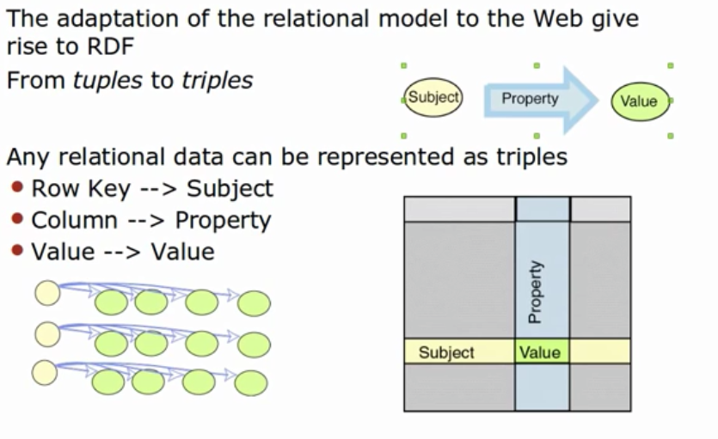
Notes:
Imagine when we have the normal relational data tables ,we have columns and rows and then
whenever a column meets a row we have a value ,well we can use that as the idea behind the triple .So for a row we can use that as a
subject ,for column we can use that as a property and for the value we can use that as our object .
Instead of having multiple rows and multiple columns we can have
everything (every value in that in a table) in a triple ,Thus triple is subject predicate and object .
Imagine if one asks you to sort or merge different tables from different databases from different places in the world ,say one table has 50 columns another
table has 20 columns a third table has 90 columns how can you merge these tables it's virtually impossible because
they have different structure, but if we present them as triples then they will all have the same structure “subject predicate object” or
“subject property value” and using that we can actually merge.

Slide 19
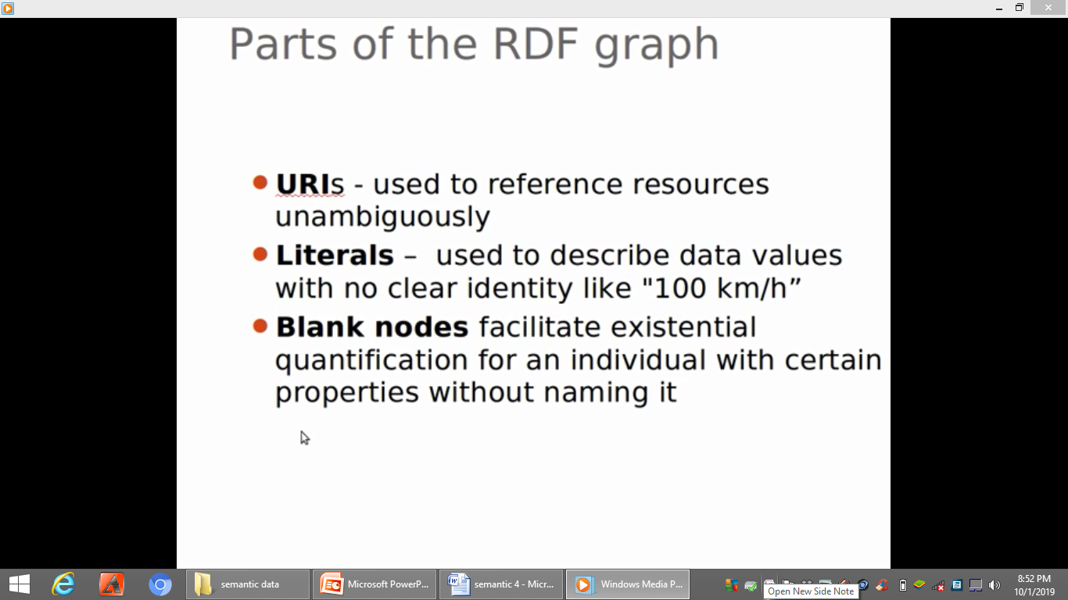
Parts of RDF Graphs
Notes:
RDF data is usually a graph & part of that graph are the URIs which are generally used to reference resources
and bit unambiguously ,we must make a difference because if we use the same word from two different namespaces then we need to know where
they are coming from so we can know the context ,literals - these are data values and usual used to describe data values with no clear identity

Slide 20
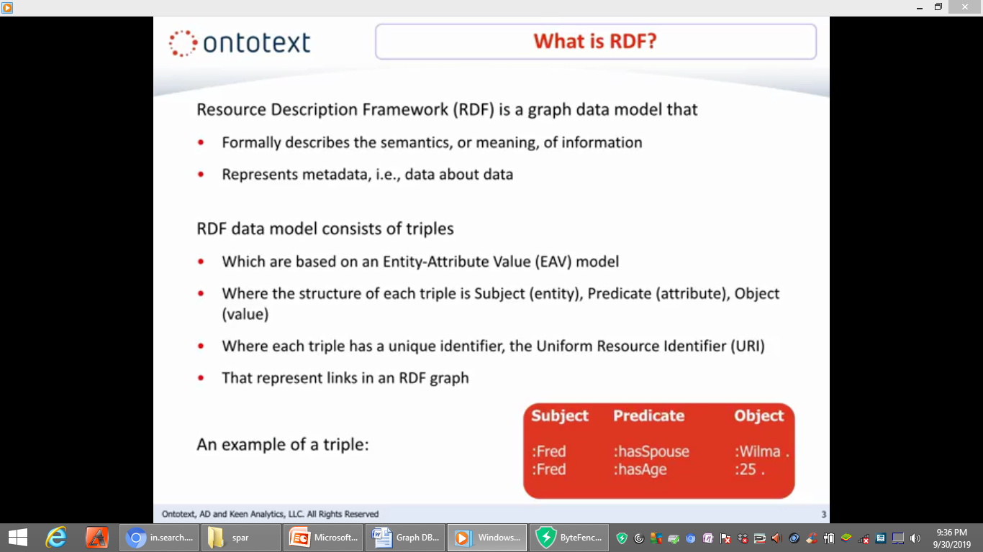
WHAT IS RDF?

Slide 21
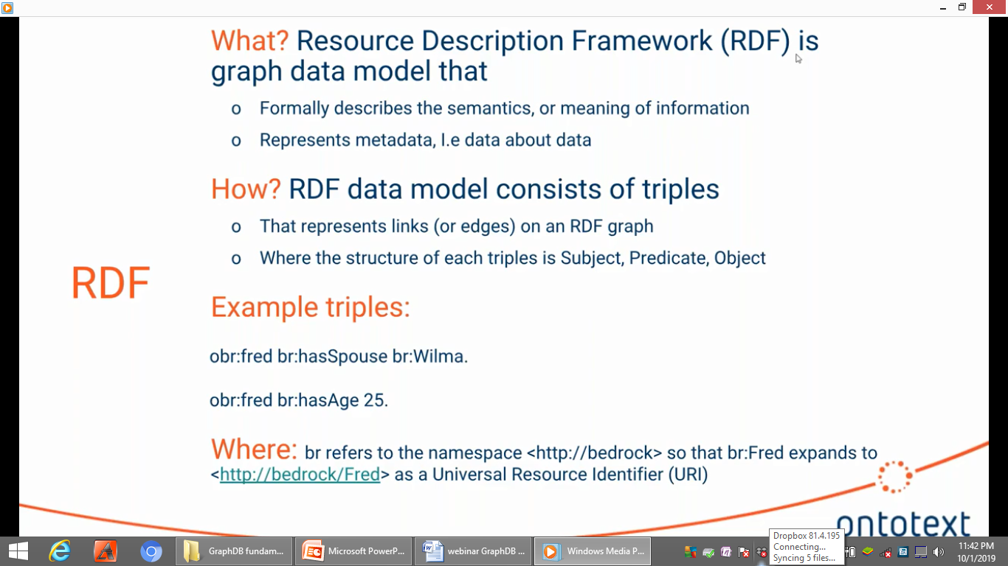

Slide 22
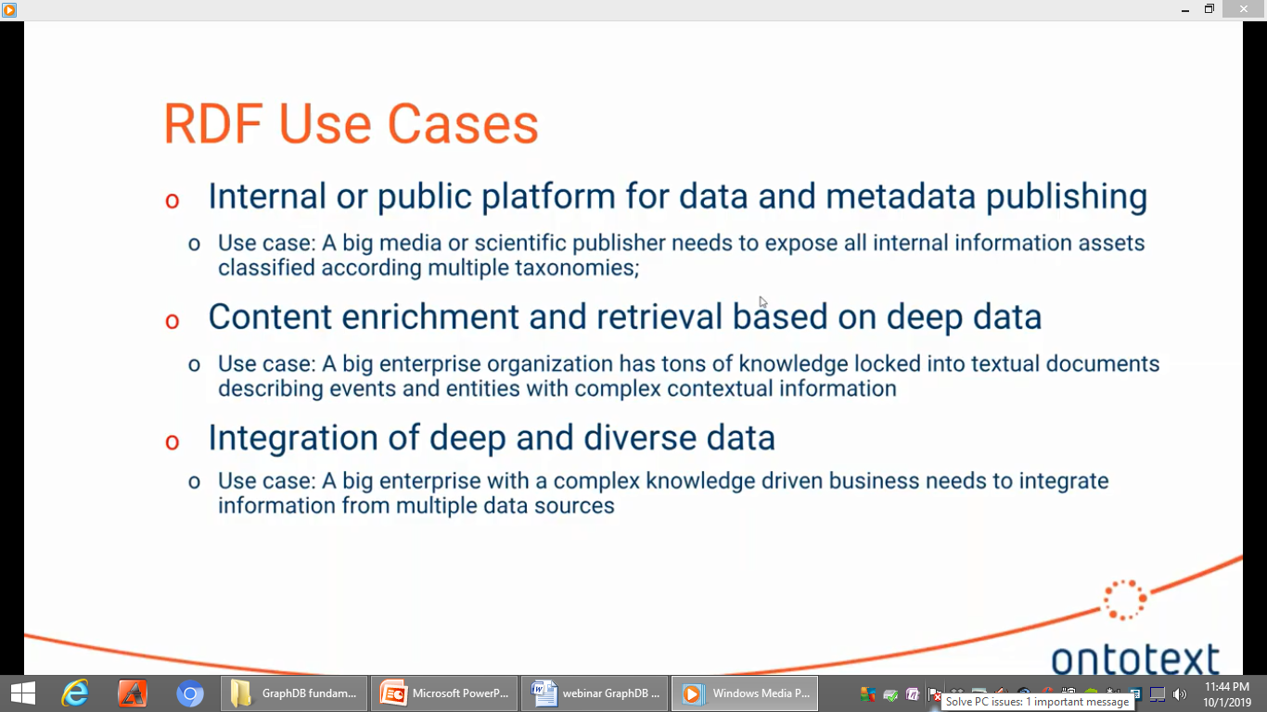

Slide 23
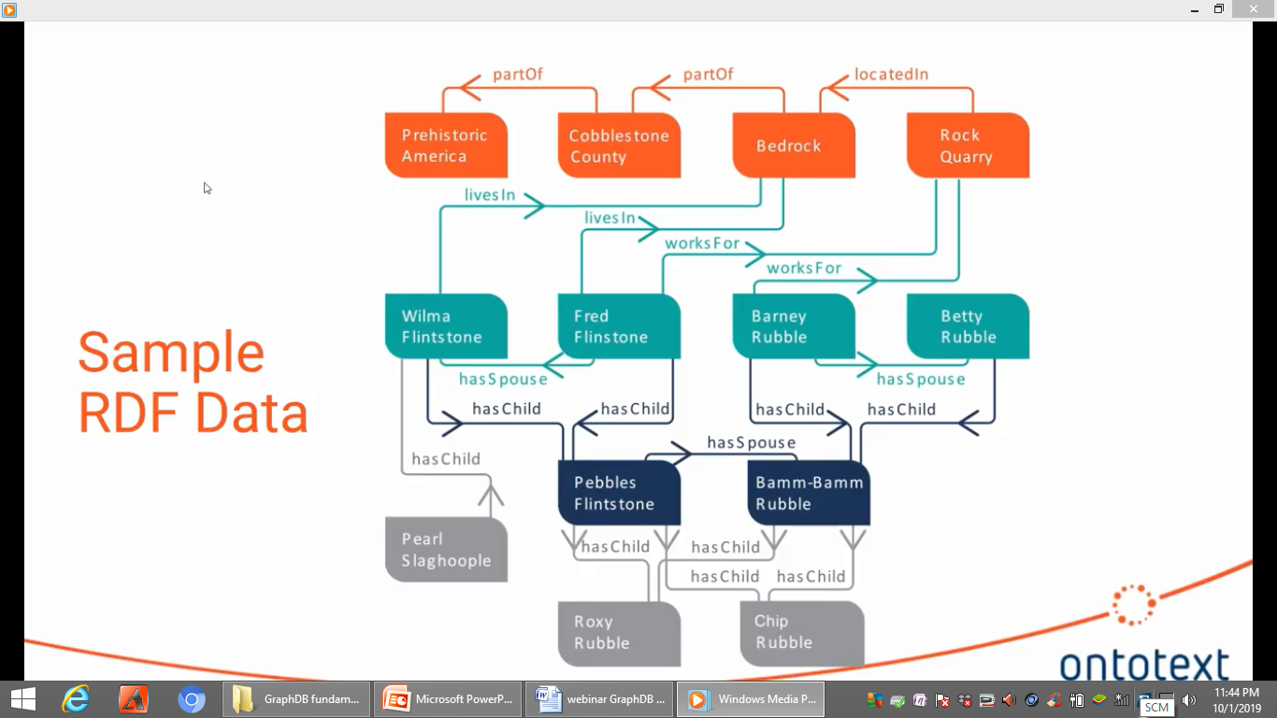

Slide 24
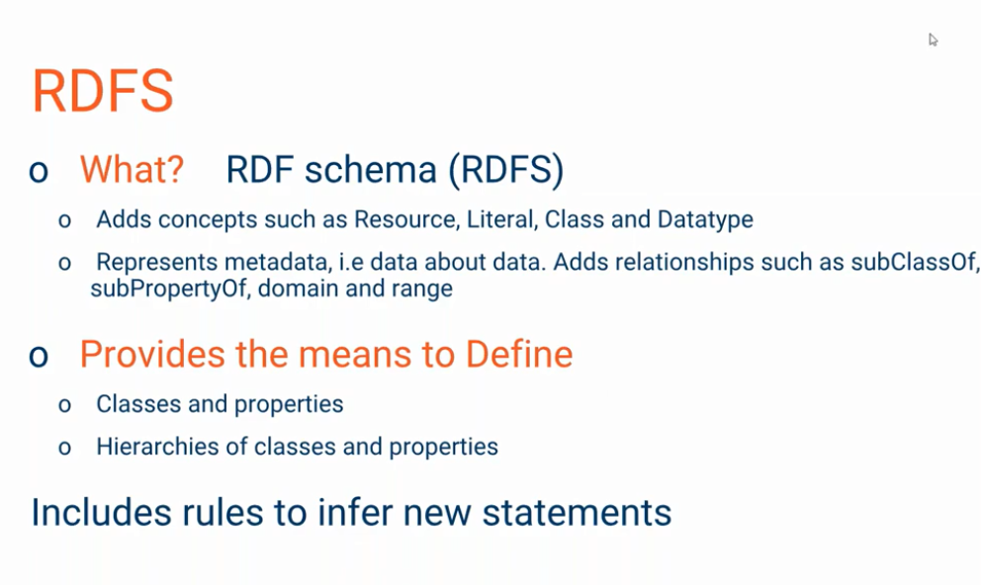

Slide 25
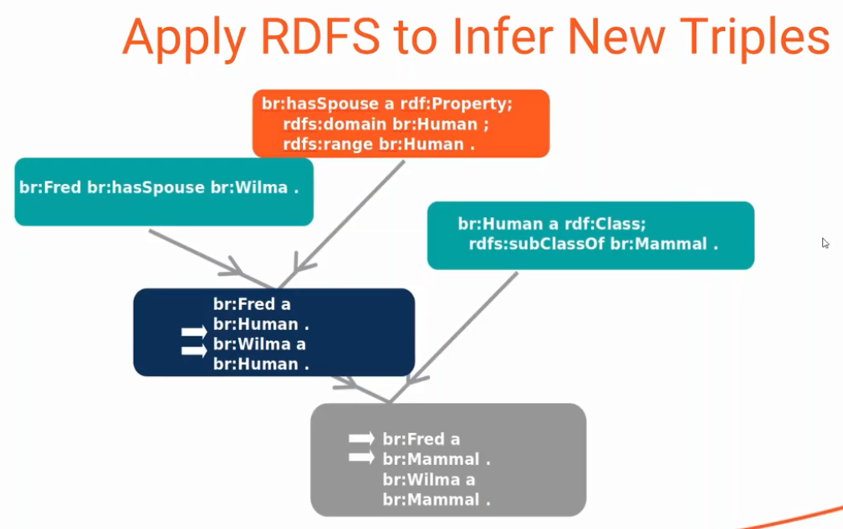

Slide 26
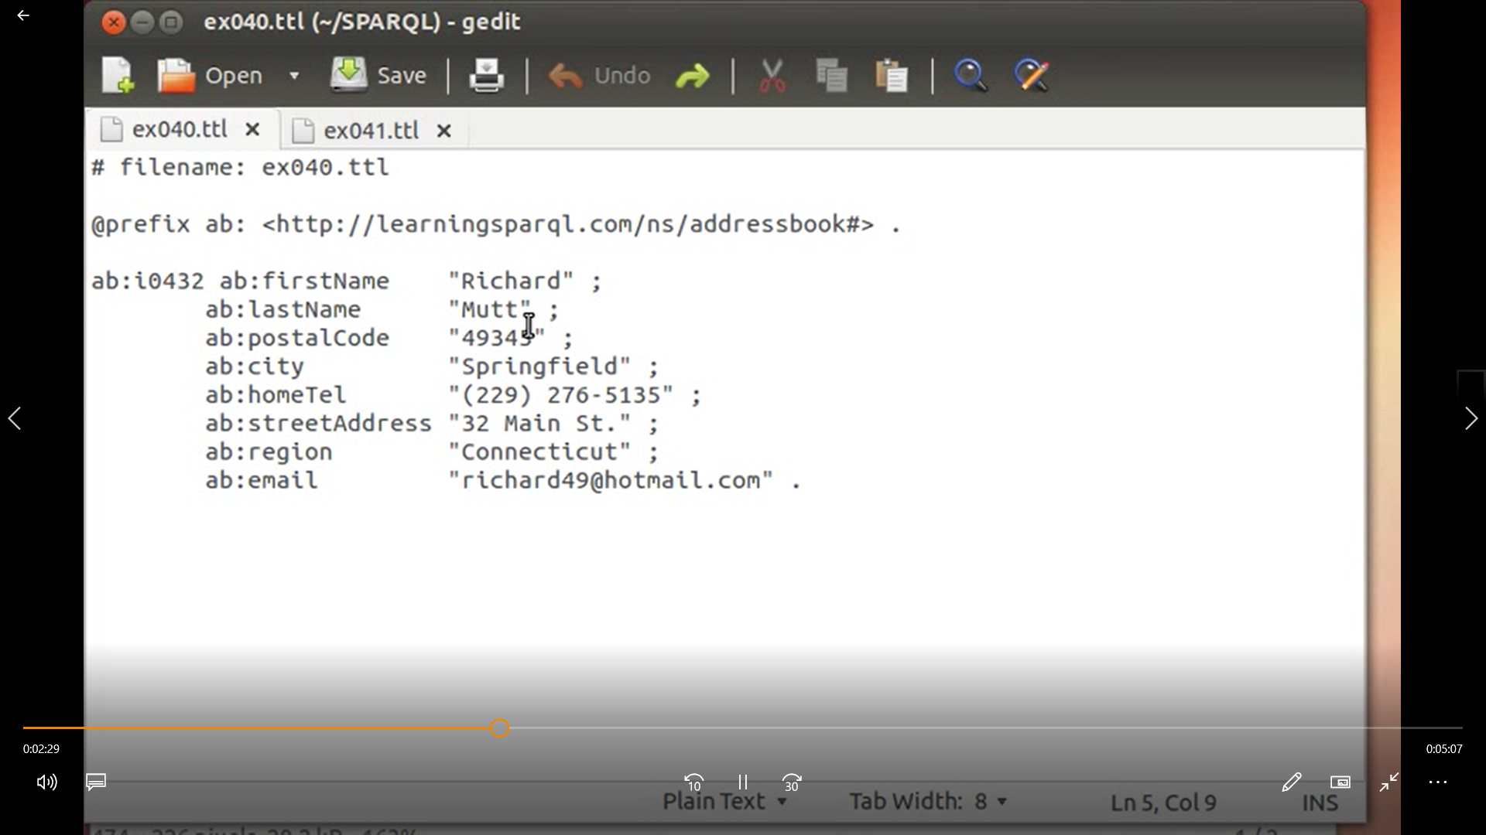
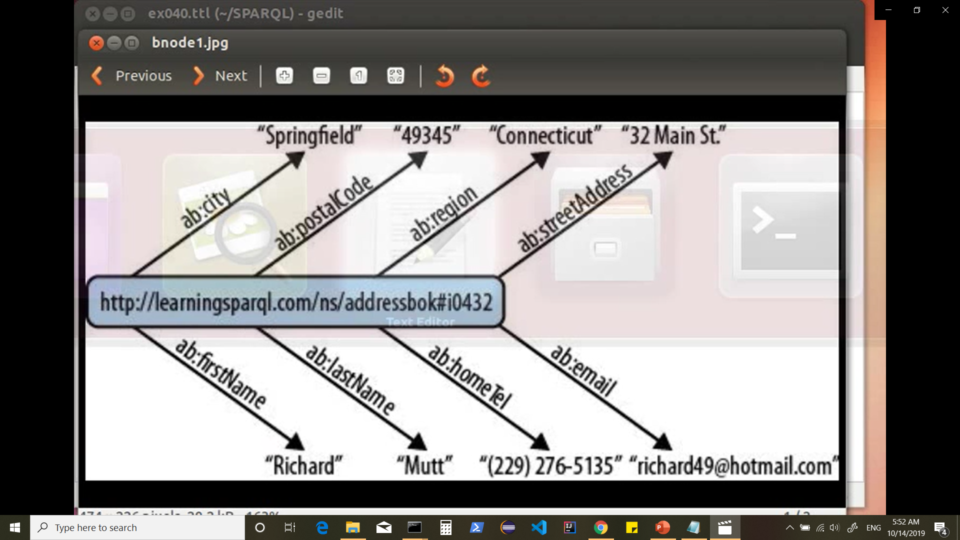
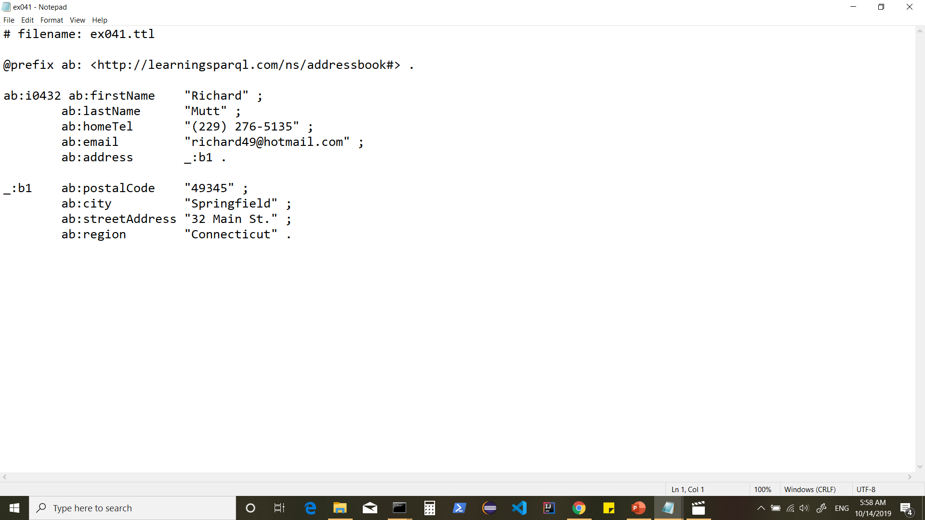
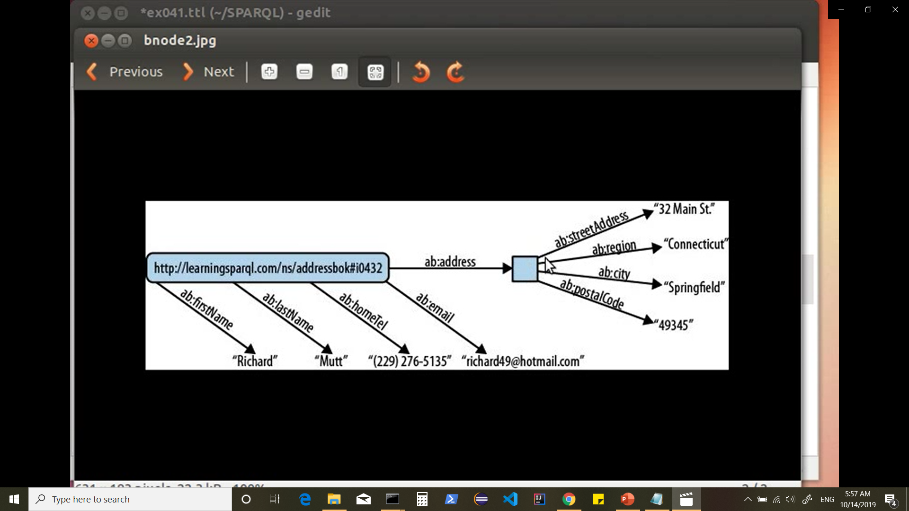
Concept of Blank Nodes

Slide 27
Named Graphs
A triple dataset ( a set of RDF triples) is a graph (RDF Graph)
Multiple RDF Graphs can be merged into one “default graph”
The datasets we specify are added together to form “default graph”
To identify source of origin(provenance) Named Graphs can be used.
Named Graphs are a convenient mechanism of “partitioning” a triple store ie storing many independent but possibly related graphs.
Names for the named graphs are URIs ,so we can refer them in RDF Statements.

Slide 28
Why Sparql?
Sparql Lets us:
Pull values from structured and semi-structured data represented in RDF.
Explore RDF data by querying unknown relationships.
Perform complex joins of disparate RDF repositories in a single query
Transform RDF data from one vocabulary to another.
Develop higher-level cross-platform application.

Slide 29
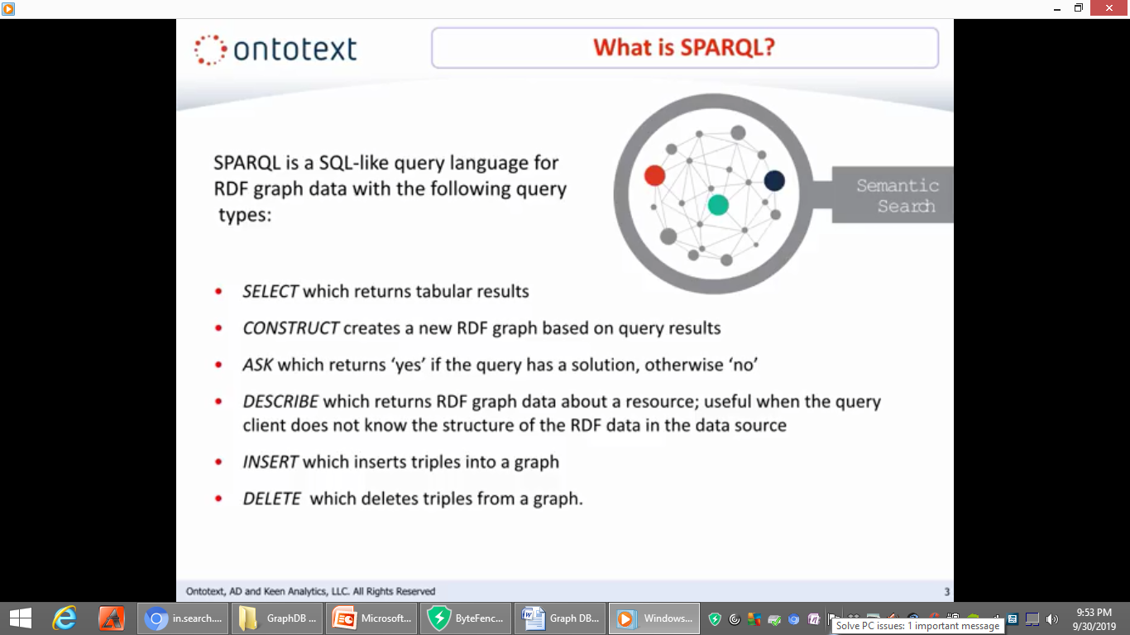
WHAT IS SPARQL?
Notes:
let's get started what is
Sparkle Sparkle is a sequel like query
language for RDF data Sparkle queries
can produce result sets that are tabular
or RDF graphs depending on the kind of
query used the sparkle select is similar
to the sequel select in that it produces
tabular results sets the sparkle
construct creates a new RDF graph based
on query results the ask query returns
yes or no depending on whether the query
has the solution describe returns the
RDF graph data about a resource this is
of course useful when the query client
doesn't know the structure of the RDF
data in the data source insert adds
triples to a graph and delete removes
triples from a graph

Slide 30
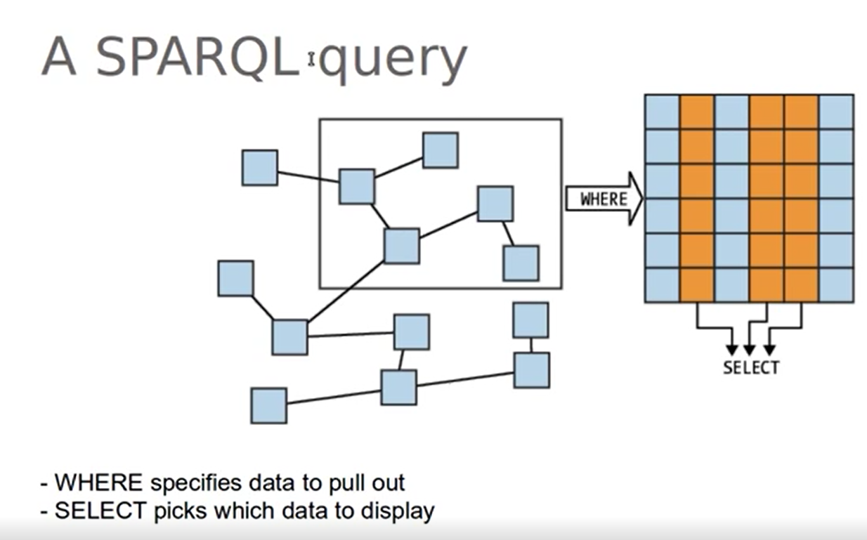
Using Sparql Query we can have a subgraph (subset of triples) from a RDF graph (collection of triples)

Slide 31
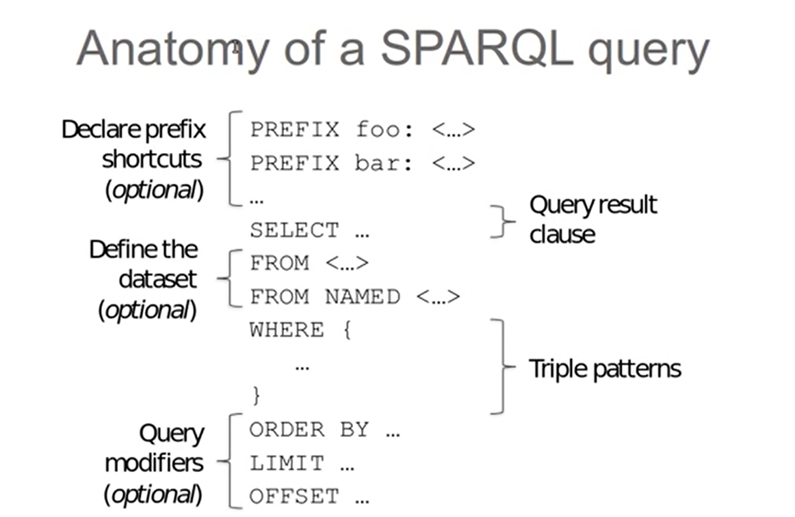

Slide 32
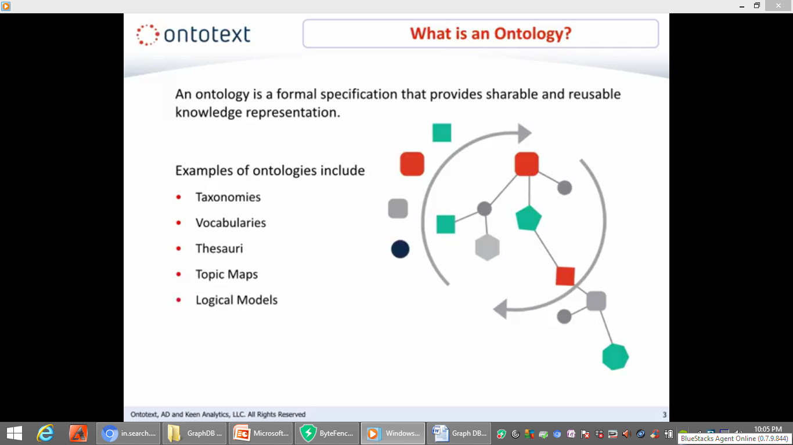
WHAT IS AN ONTOLOGY?
Notes:
What is an ontology an ontology is a formal specification that provides shareable and reusable knowledge representation
Examples of ontologies include
taxonomies vocabularies the thesauri topic
maps and logical models

Slide 33
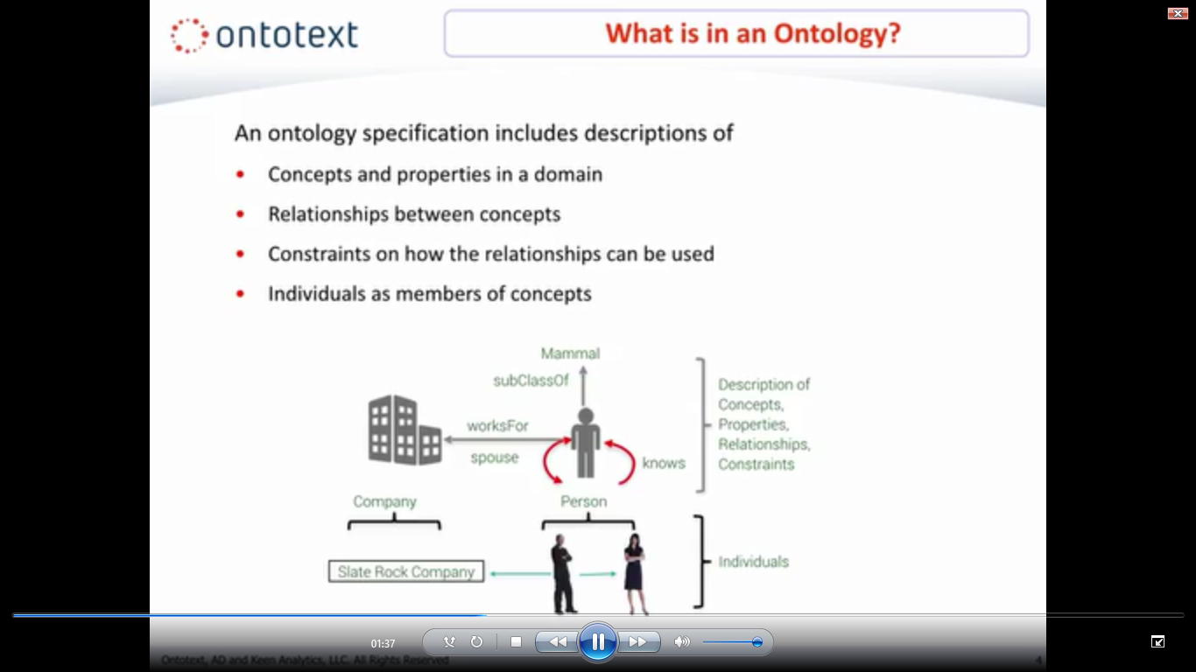
WHAT IS AN ONTOLOGY?
Notes:
an ontology specification includes descriptions of concepts and properties in a domain relationships
between concepts constraints on how the relationships can be used and individuals as members of concepts
In the example below we can classify the two individuals Fred and Wilma in a
class of type person and we also know
that a person is a mammal.
Fred works for the slate rock company and the slate rock company is of type company so we also know that person works for company

Slide 34
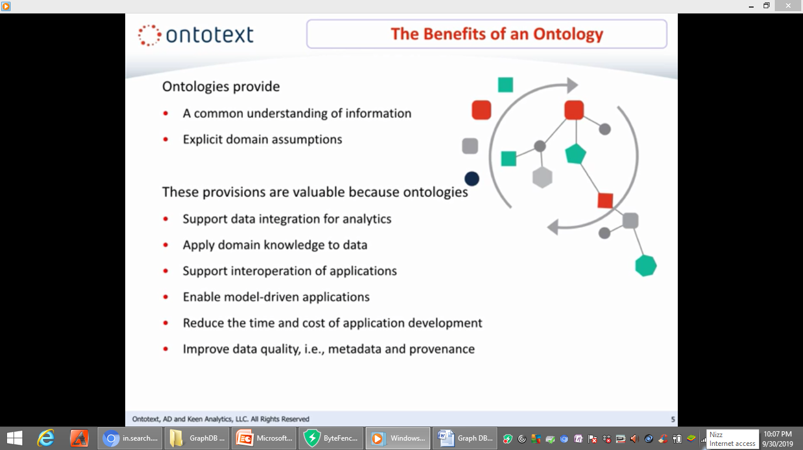
THE BENEFITS OF AN ONTOLOGY
Notes:
So why develop an ontology.
first ontologies are very useful in gaining a common understanding of information and making assumptions explicit in ways that can be
used to support a number of activities .These provisions a common understanding of information and explicit domain
assumptions are valuable because ontologies support data integration for analytics ,apply domain
knowledge to data support application,interoperability,enable model driven,applications reduce time and cost of application development and improve data
quality by improving metadata and provenance.

Slide 35
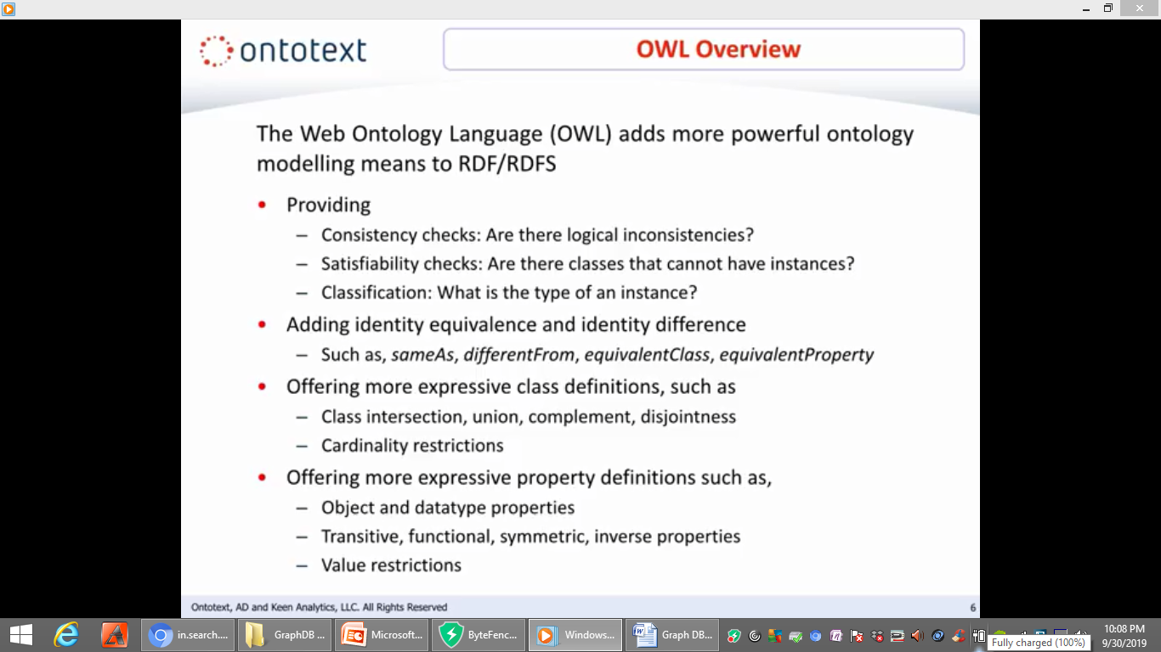
OWL OVERVIEW
Notes:
The web ontology language or OWL adds more powerful ontology modeling means to RDF and RDFS thus when used
like in graph DB it provides consistency checks .It also provides satisfiability checks such as are there classes that cannot have
instances and OWL provides classification such as the type of instance OWL also adds identity equivalence and identity
difference such as sameas, differentfrom ,equivalentclass and equivalentproperty .in addition OWL offers more
expressive class definitions such as class intersection ,Union complement,disjointness and cardinality restrictions
finally OWL offers more expressive property definitions such as object and data type properties transitive functional symmetric inverse properties and value restrictions

Slide 36
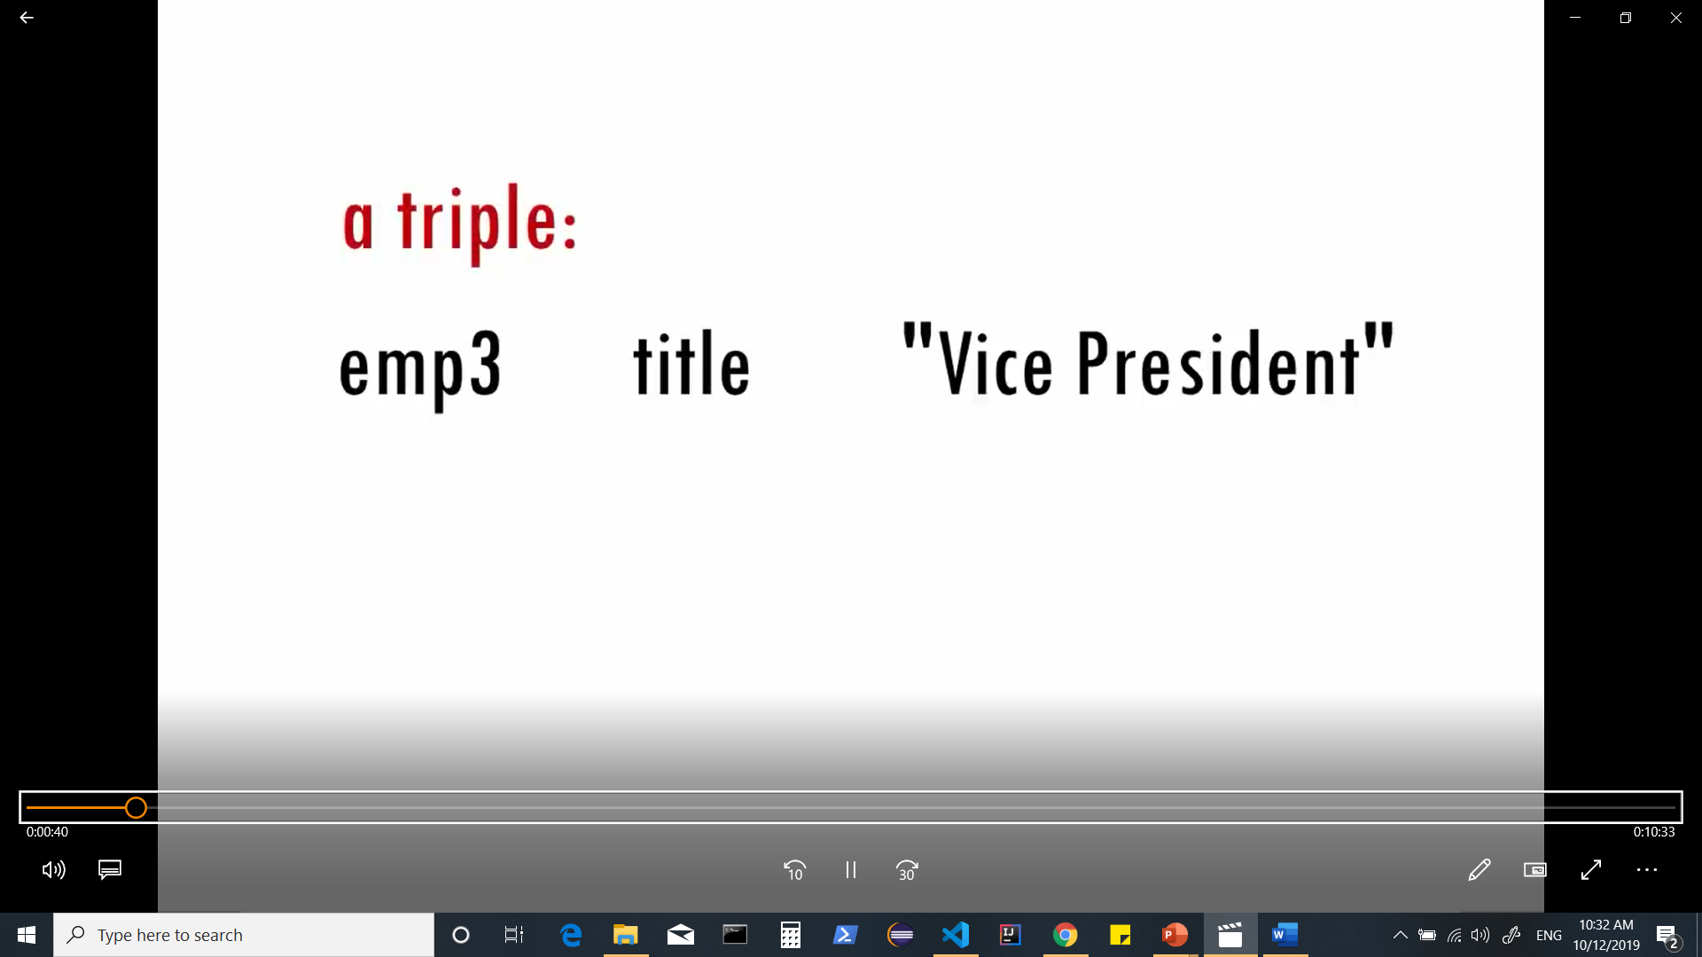
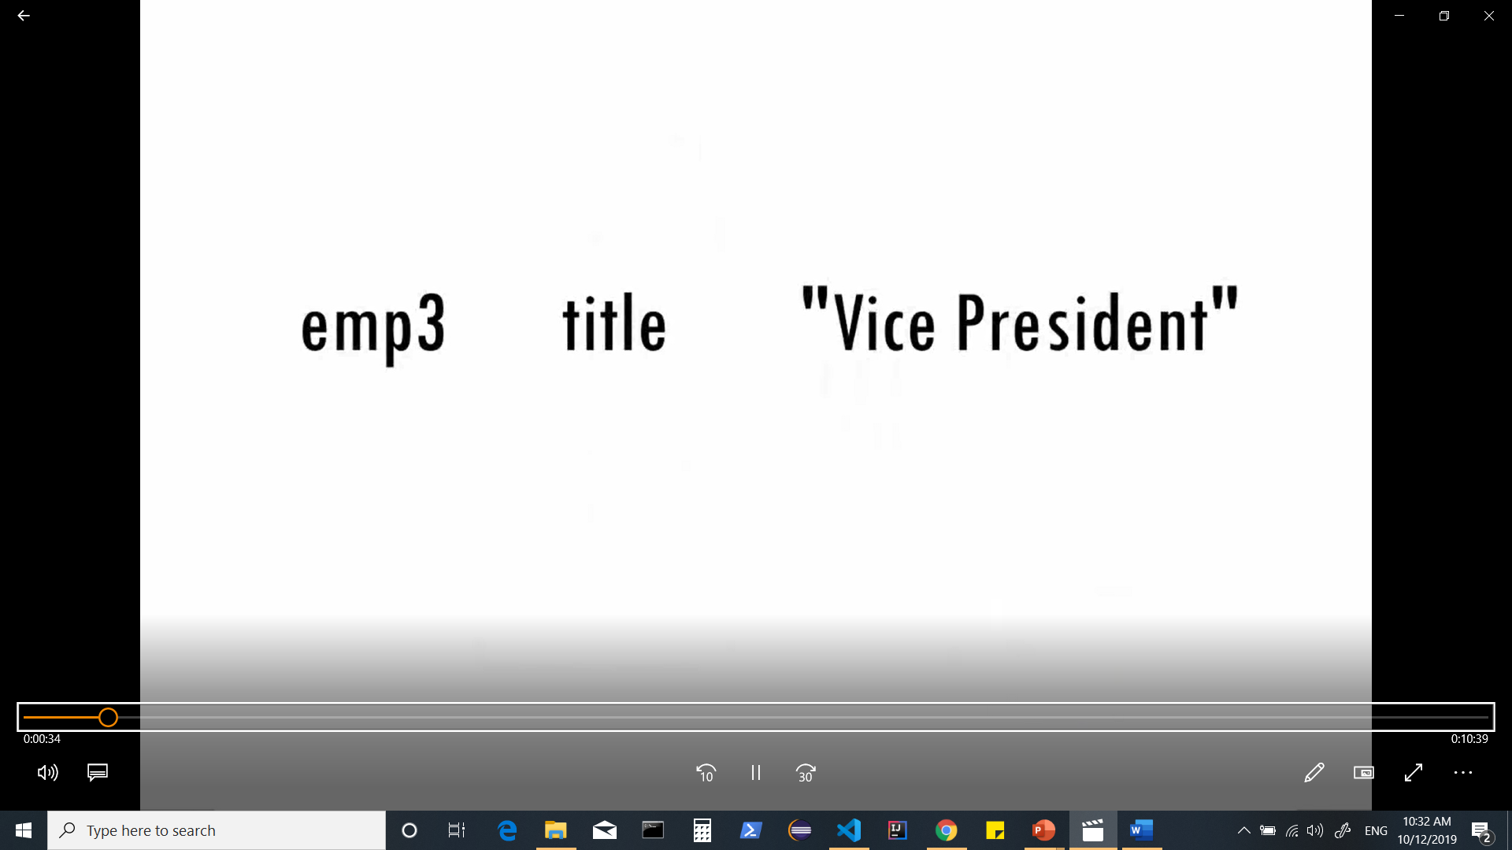
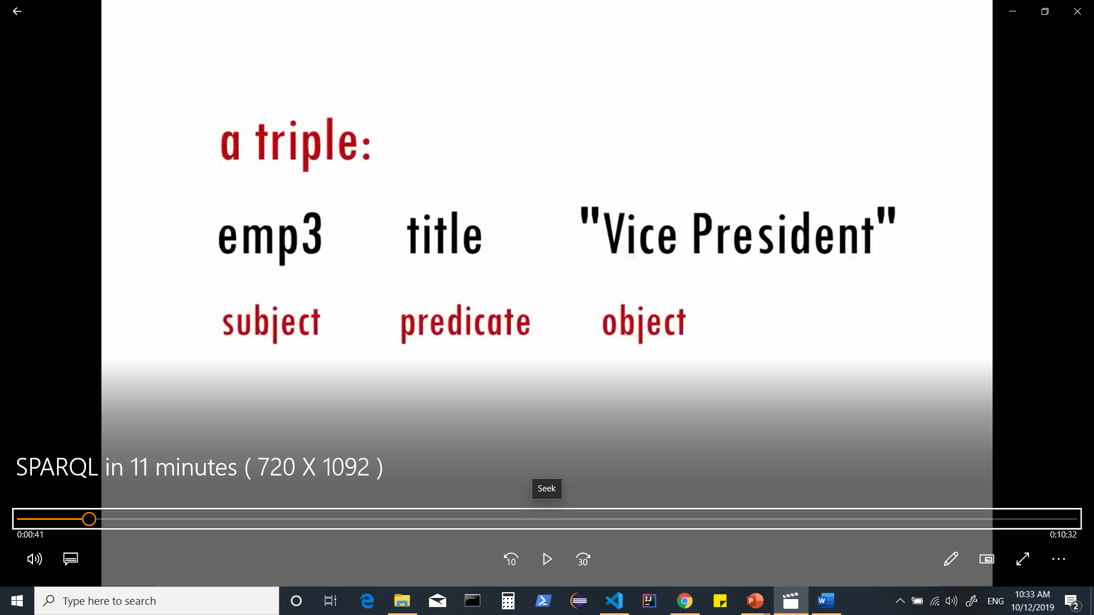
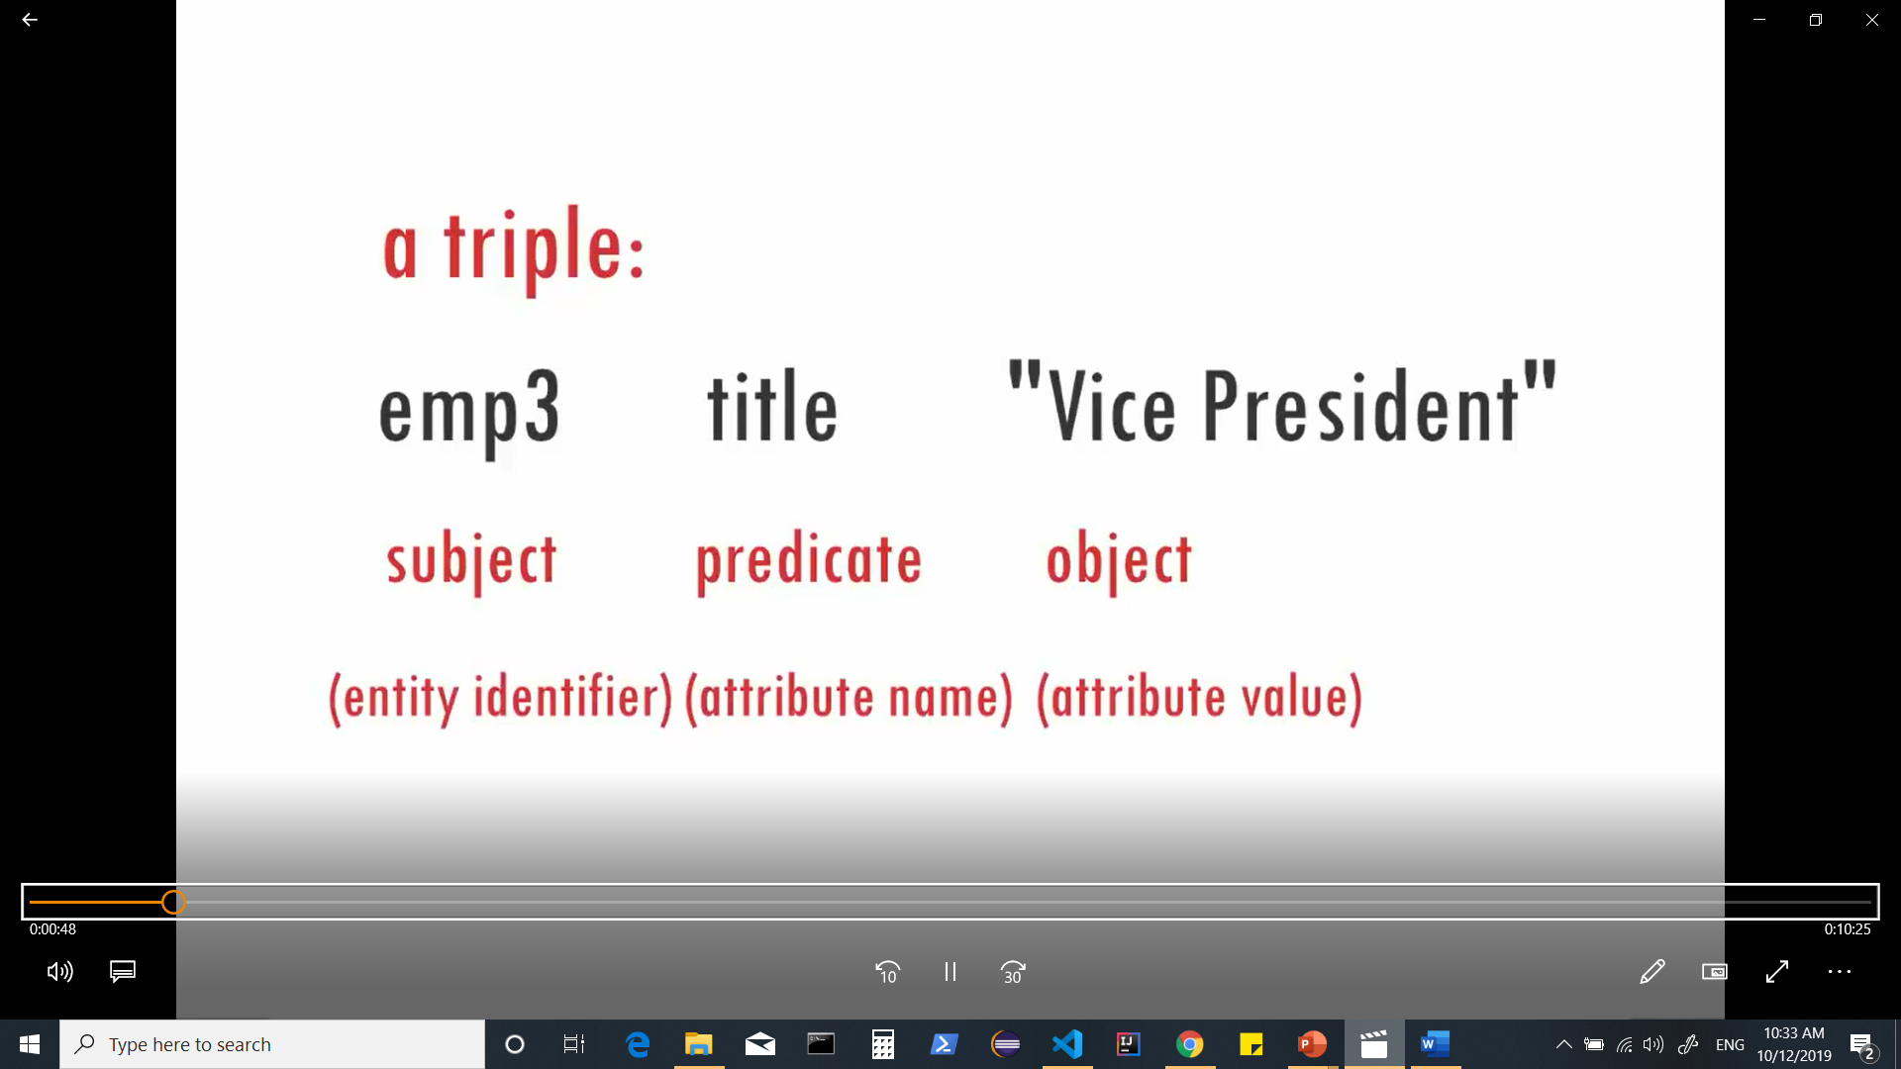
Notes:
RDF lets you describe data using a collection of three-part statements such as “employee 3” has a title of “vice president” .
We call each statement a triple and we call its three parts the subject, predicate and object .
You can think of them as an entity identifier an attribute name and an attribute value

Slide 37
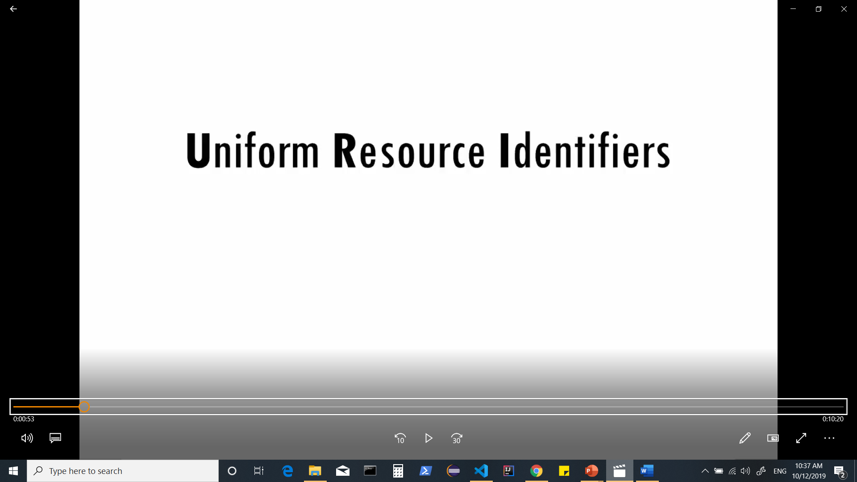
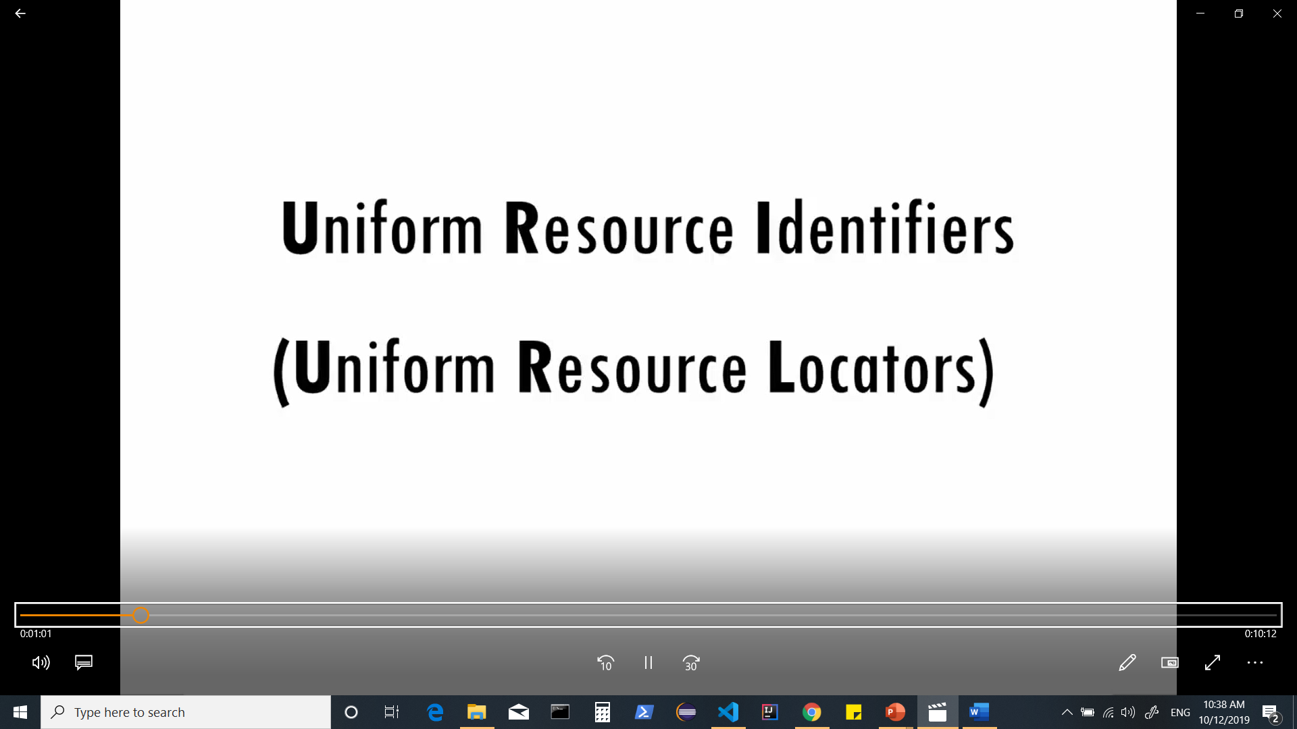
Notes:
The subject and predicate are actually represented using URIs to make it absolutely clear what we're talking about.
URIs are kind of like URLs and often look like them but they're not locators or addresses they're just identifiers

Slide 38

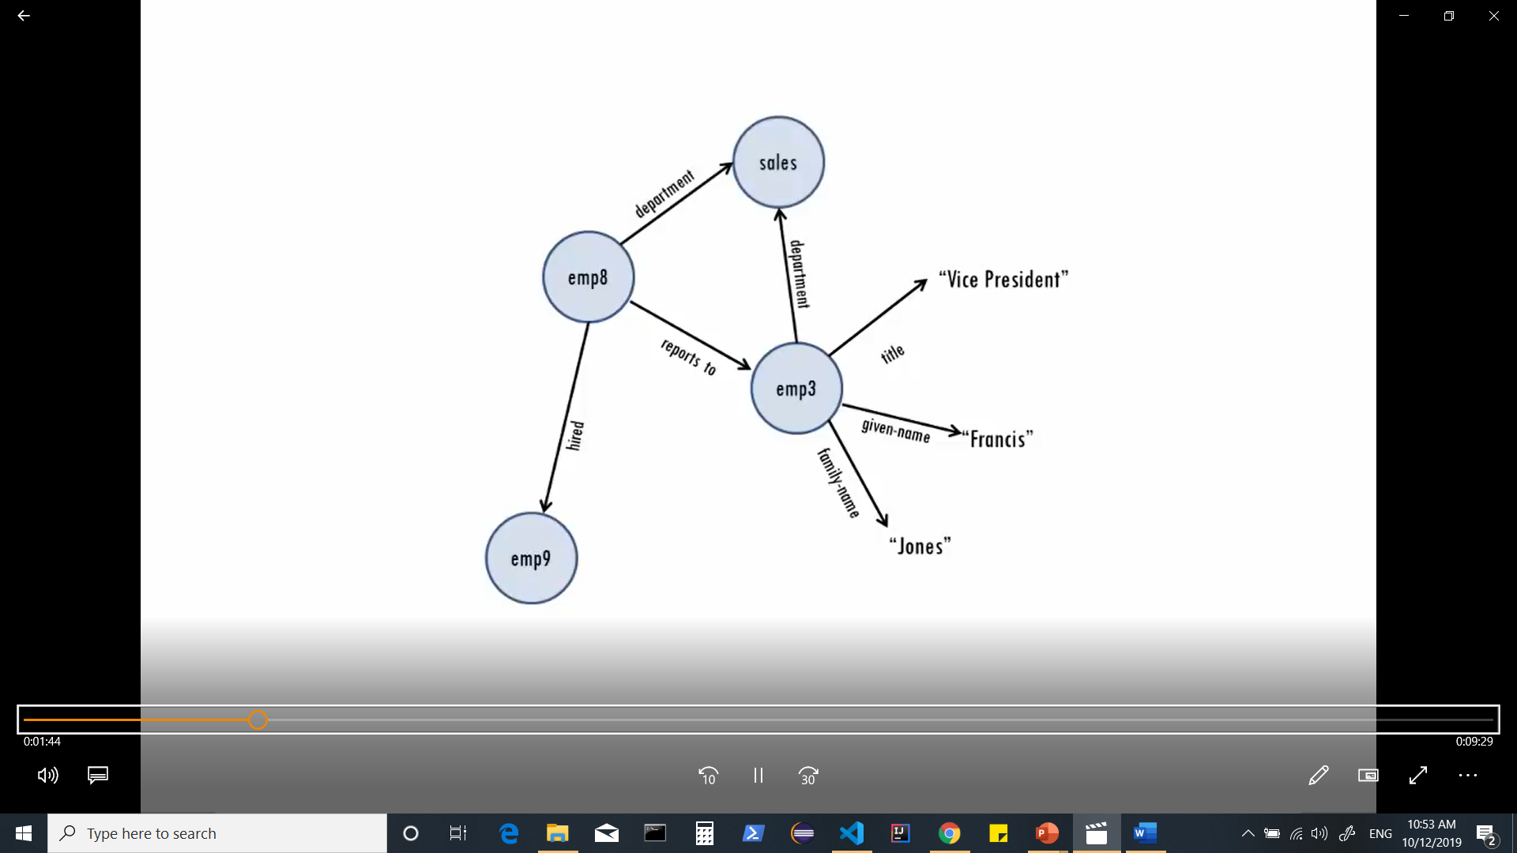
Notes:
These URIs show that we mean employee 3 from a specific company and that we mean title in the sense of job title and not a
label for a book movie or other creative work because we're using the URI for title defined by the w3c’s published version of the vcard business card Ontology.
The object or third part of a triple can also be a URI , if you like. This way the same resource can be the object of some triples and the subject of
others which lets you connect up triples into networks of data called graphs.

Slide 39
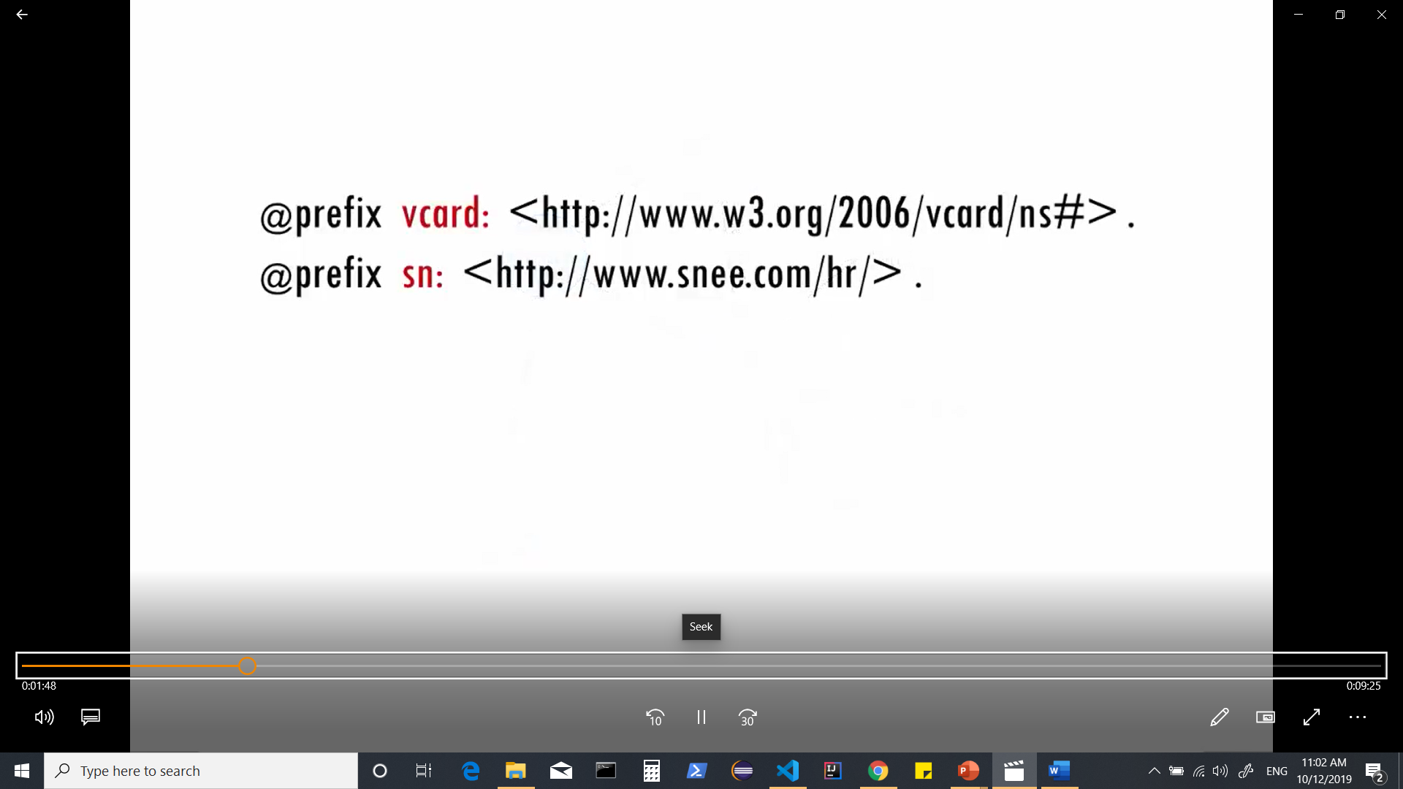
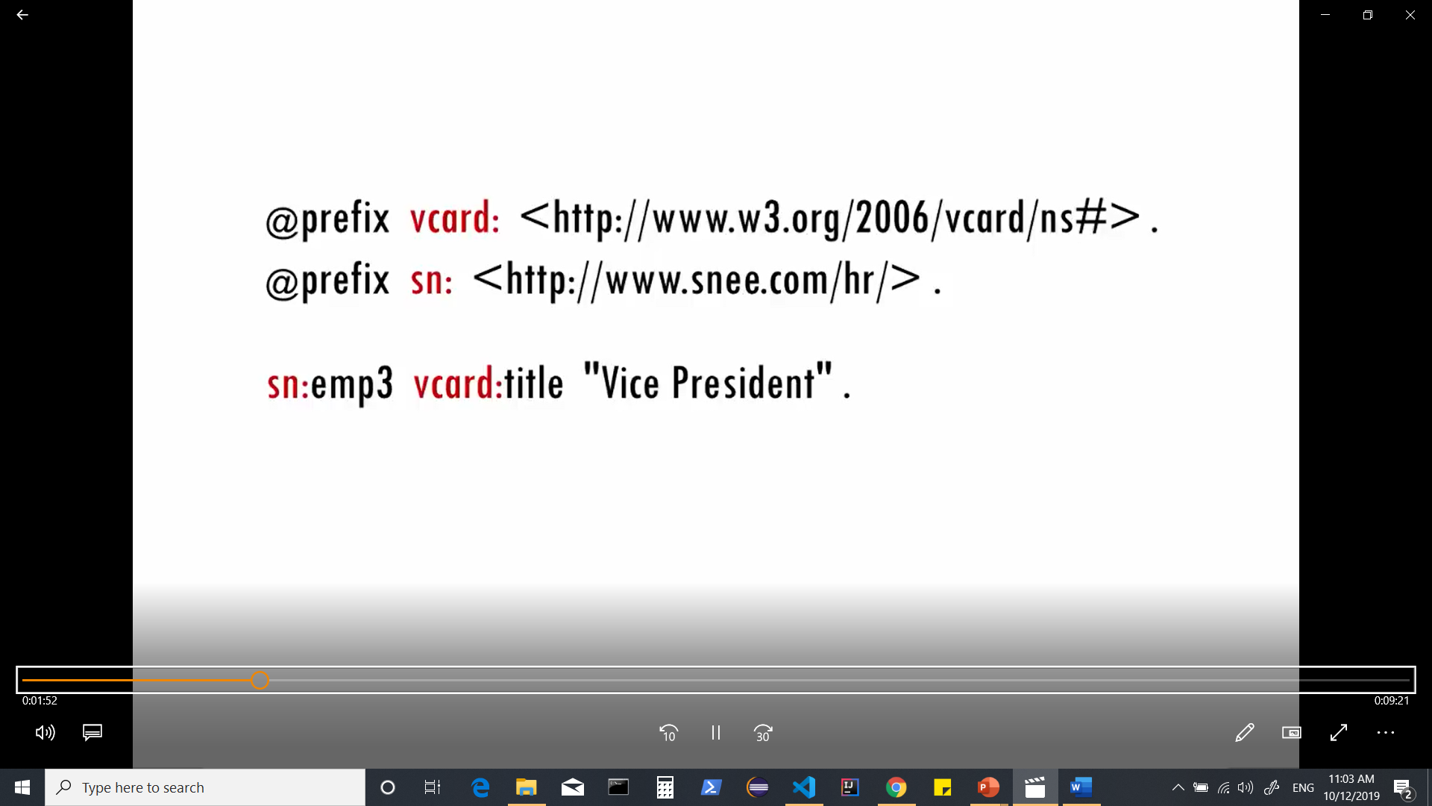
To make URIs simpler to write, RDFS popular turtle syntax often shortens the URIs by having an abbreviated prefix stand-in for everything in the URI before the last part.
Notes:
To make URIs simpler to write, RDFS popular turtle syntax often shortens the URIs by having an abbreviated prefix stand-in for everything in the URI before the last part.

Slide 40
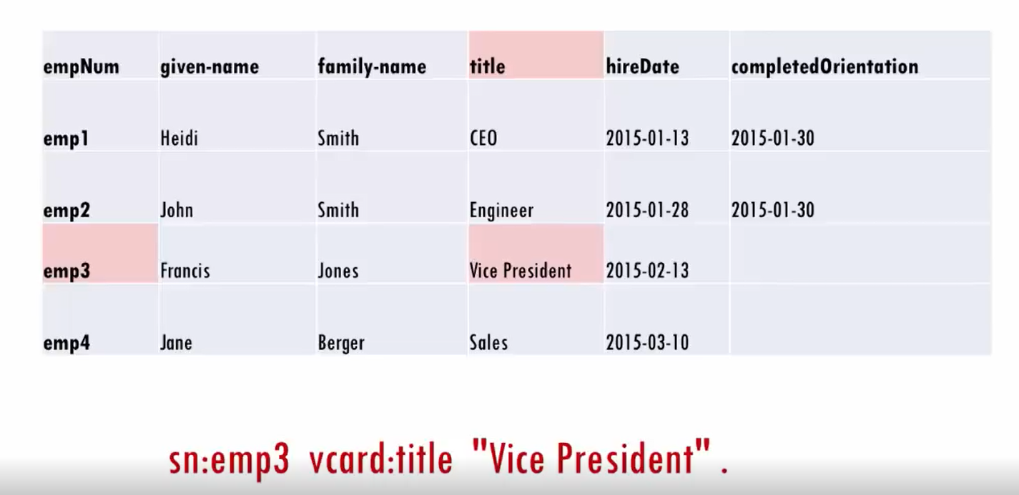
Notes:
just about any data can be represented as a collection of triples for example we can usually represent each entry of a table by using
the row identifier as the subject
the column name is the predicate
and the value as the object this can give us triples for every fact on the table.

Slide 41
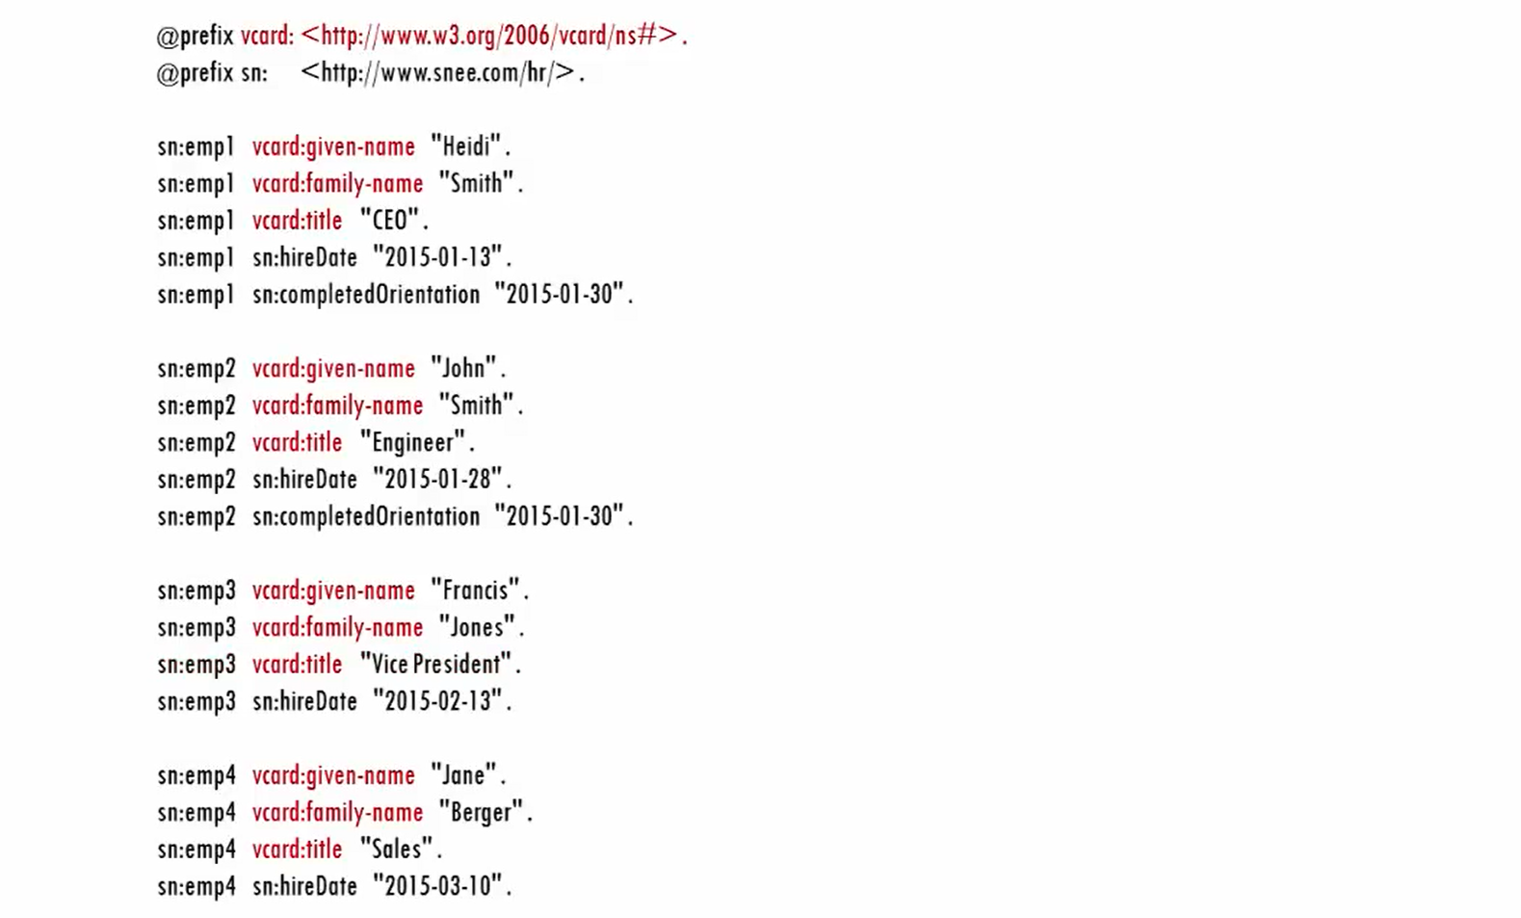
Notes:
some of the property names here come from the vCard vocabulary

Slide 42
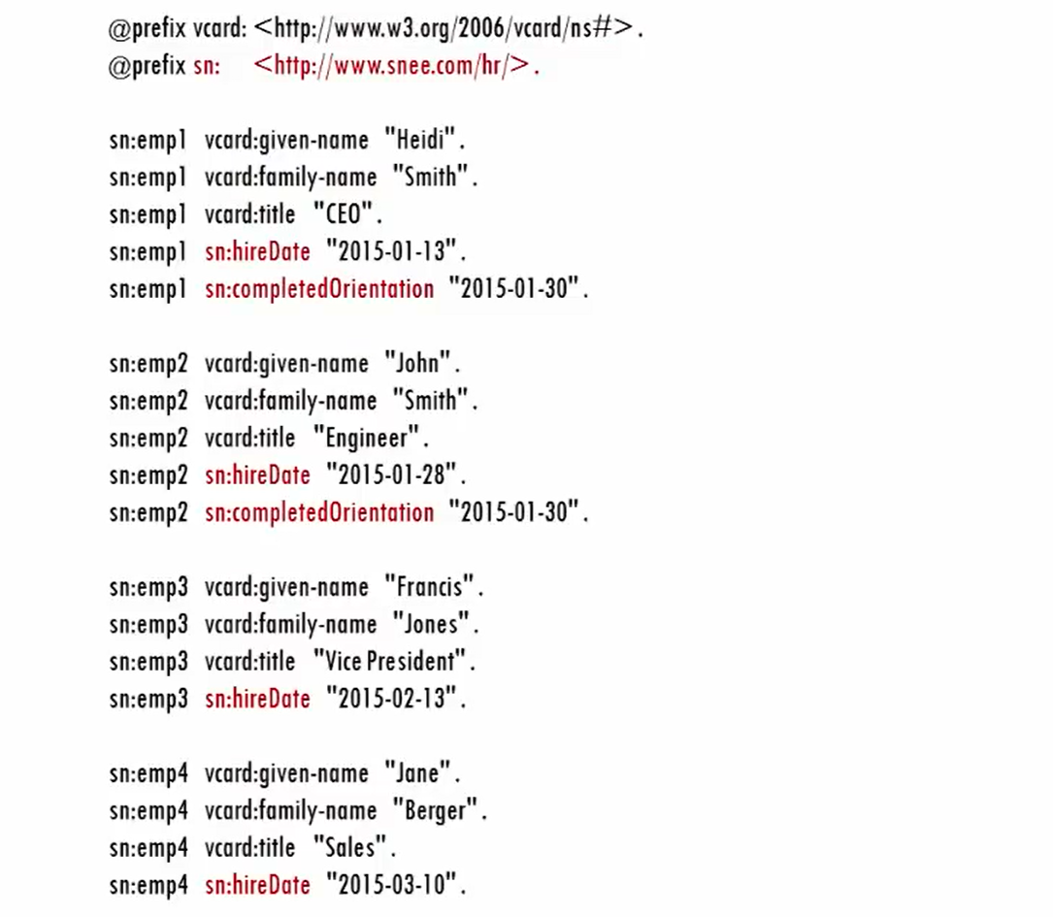
RDF makes it easy to mix and
match standard vocabularies and customizations
Notes:
for the properties not available in vCard we can make up our own property names using our own domain name.

Slide 43
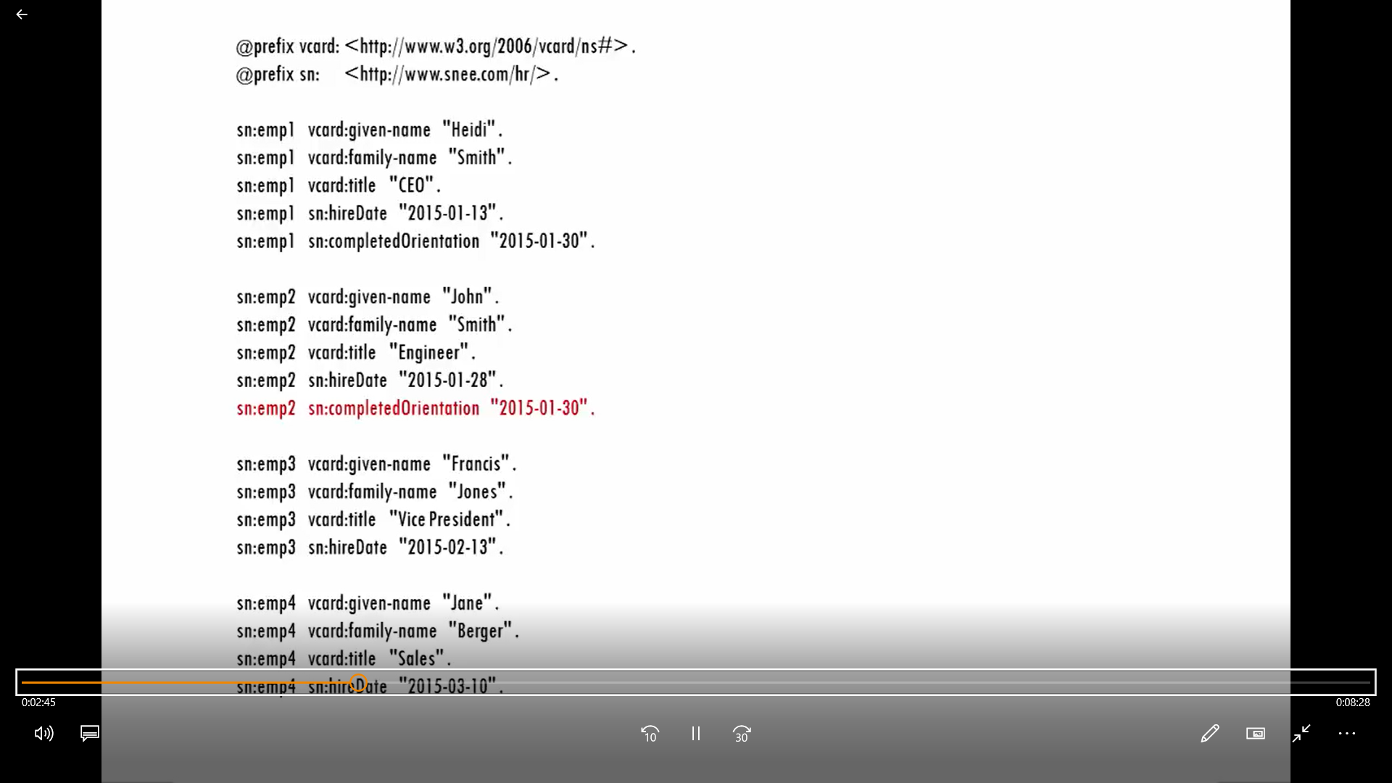
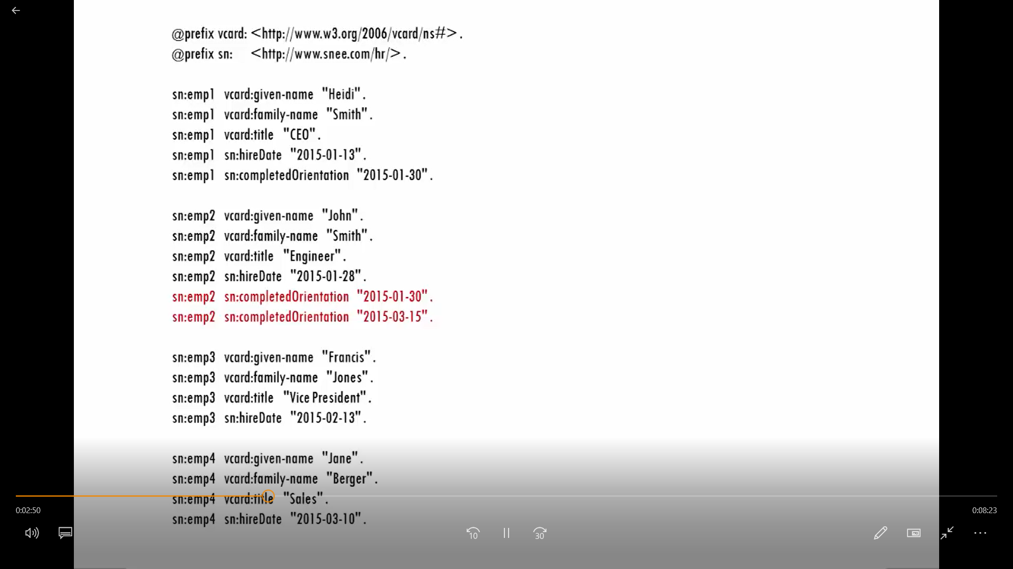
Notes:
let's say that of the employees on this table John Smith completed the employee orientation course twice and we want to store both
of his completed orientation values ,this is no problem with RDF.

Slide 44
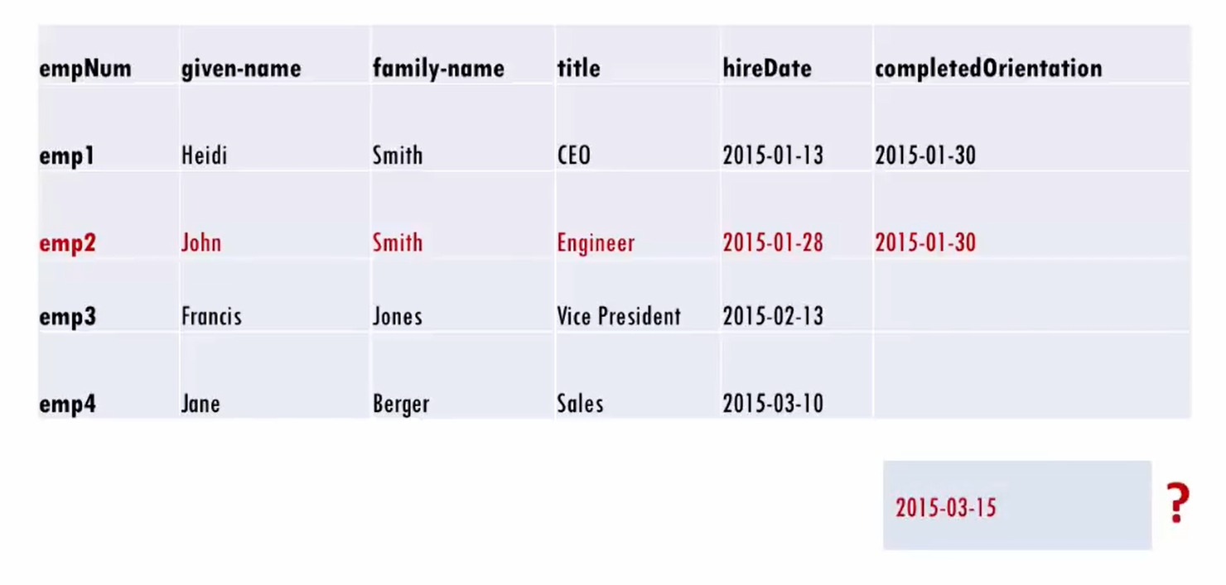
If the original data had been stored in a relational database table adding John's second completed orientation value would have been a lot more difficult.

Slide 45
Quick Working Examples

Slide 46
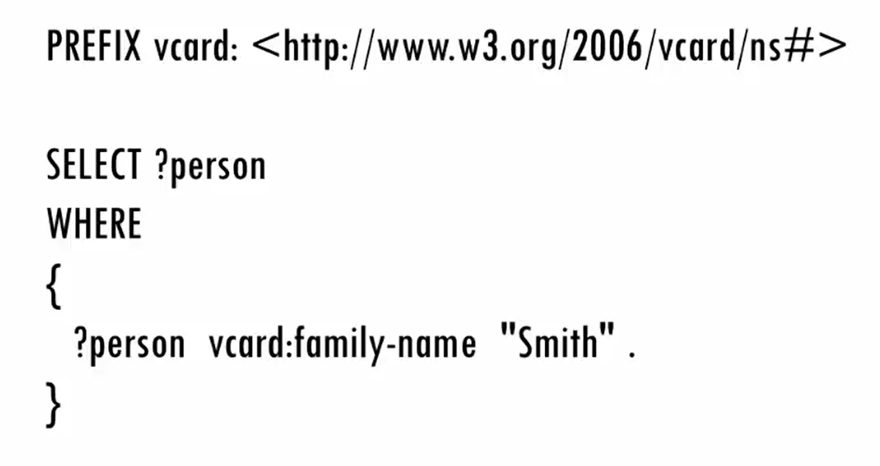
let's look at a simple sparql query that retrieves some of this data .We want a list of all the employees whose last name is Smith .
Like the turtle rdf syntax sparql lets
you define prefixes so that you don't have to write out full URIs in your
queries .
For most sparql queries it's best to look at the where clause first because that describes which triples we want to pull from the data set that we're querying ,the where clause does this with one or more triple patterns
which are like triples with variables as wildcards substituted into one two or all three of each triples parts .

Slide 47
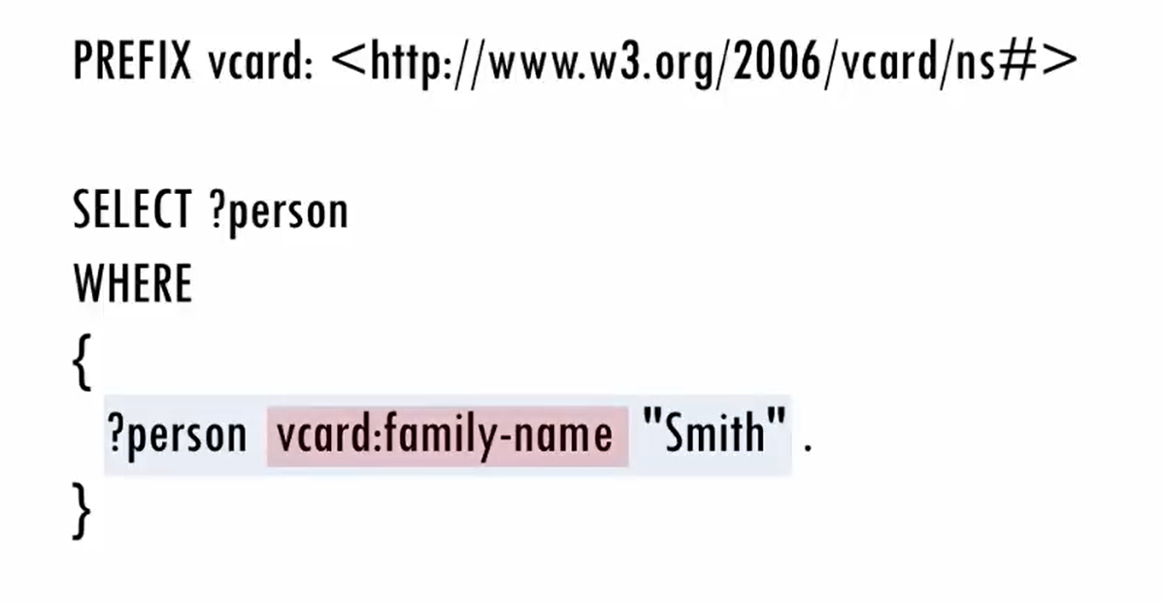
Variable- For triple Pattern
Object – String ‘Smith’
Subject- Anything
Predicate – Family Name Property from vcard vocubalary
Notes:
in this query the one triple pattern will match against triples whose predicate is the family name property from the vCard
vocabulary whose object is the string Smith and whose subject is anything at all because this triple pattern has a variable that we named person in this position

Slide 48
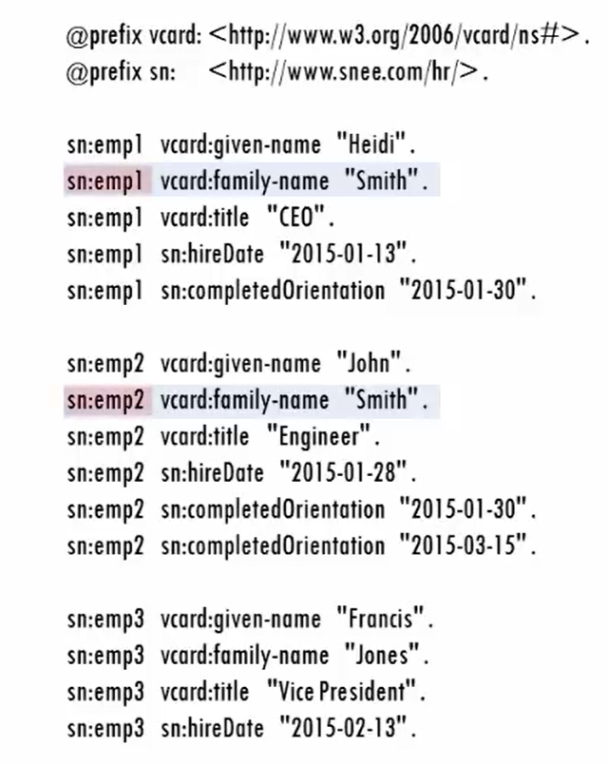
The select Clause indicates which variables values we want listed after the query execute. This query only has one variable so that's the one we want to see. When the query executes ,it finds two triples that match the specified pattern so the query’s results .i.e. the values that got assigned to the person variable will be the subjects from those two triples

Slide 49
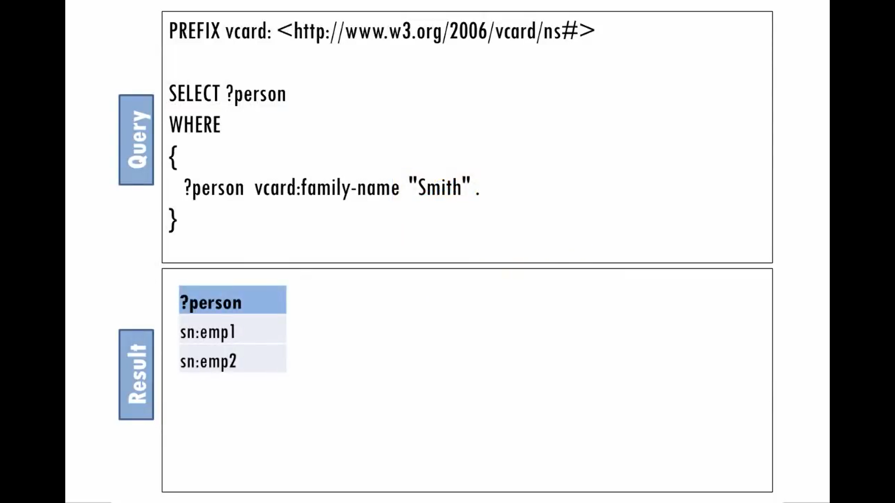
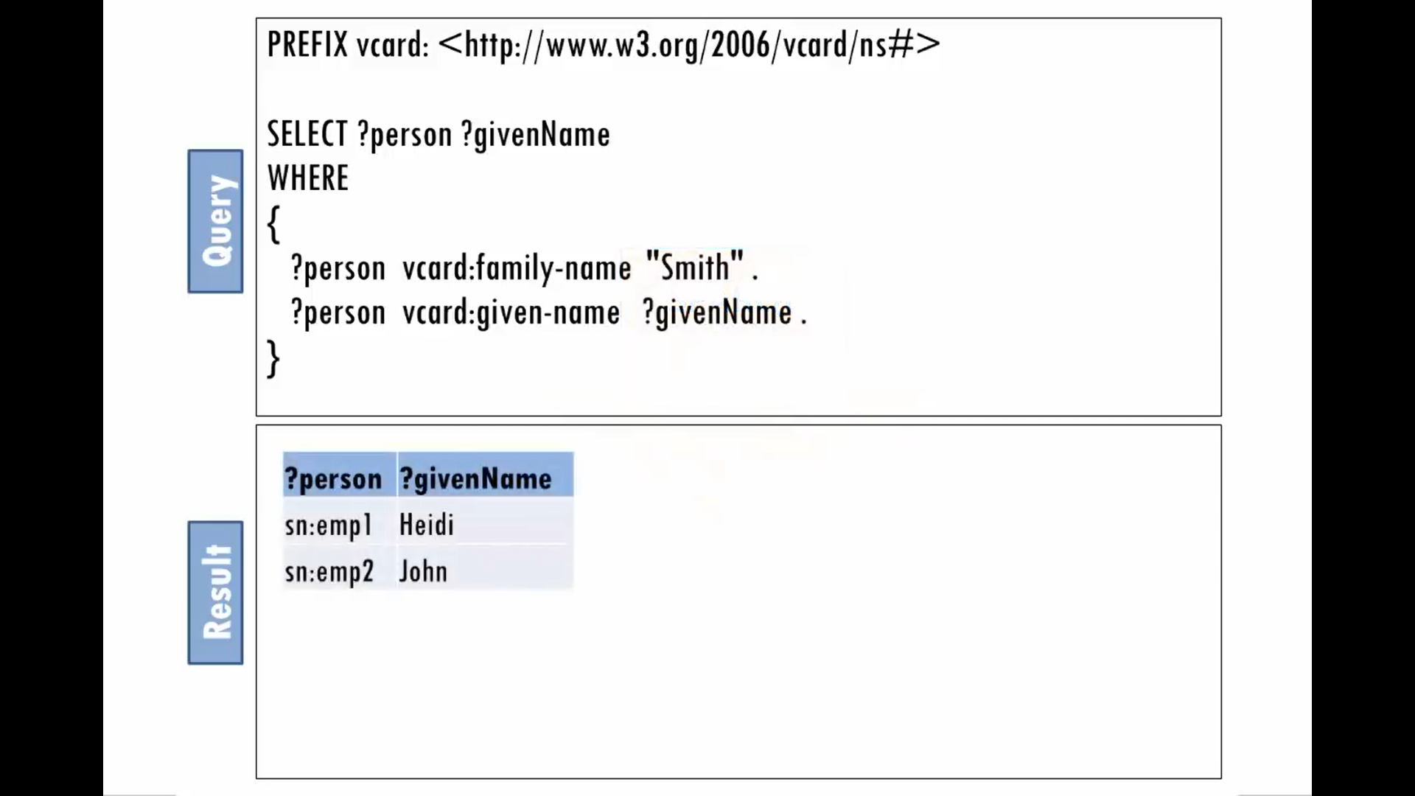
Notes:
let's execute the query and find out who are these Smiths the emp1 and emp2 identifiers listed in our first queries results don't tell us much.
let's add a second triple pattern that matches on the given name of the employees who matched the first triple pattern and stores that value in a new given name variable.
we'll also adjust the select clause to request the value of our new variable .After the query processor finds each triple that matches the first triple pattern it will remember the value it stored in the
person variable when it looks for triples that match the second one .
Of the two people who have a triple that matches the first triple pattern they each have a triple for given name as well so when we run the query we see their given name values in the result.

Slide 50
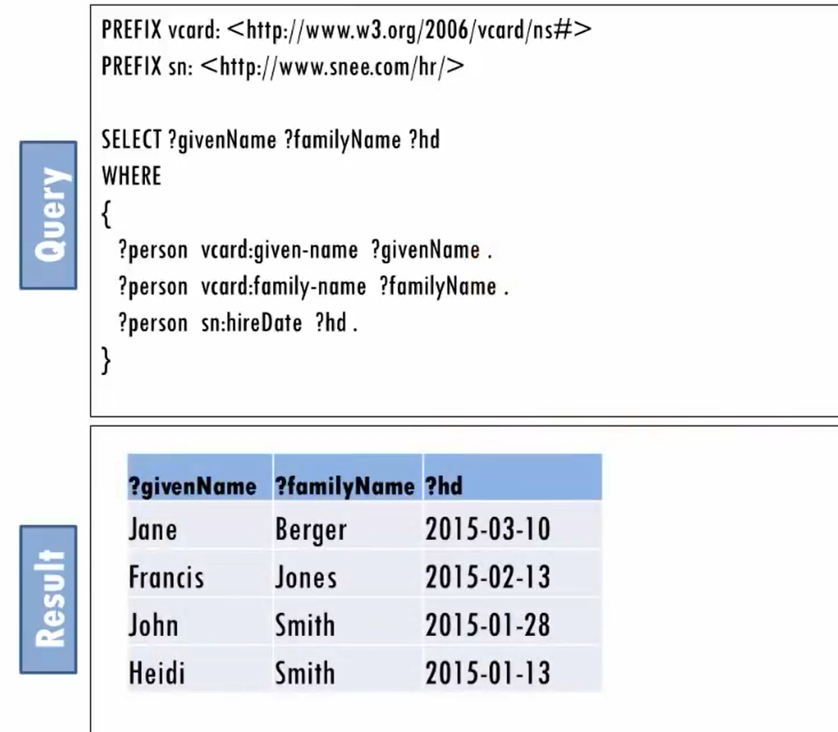
Let's retrieve the given name family name and hire date of all the employees.
We can do this with a where clause that has three triple patterns one for each
piece of information that we want to retrieve

Slide 51
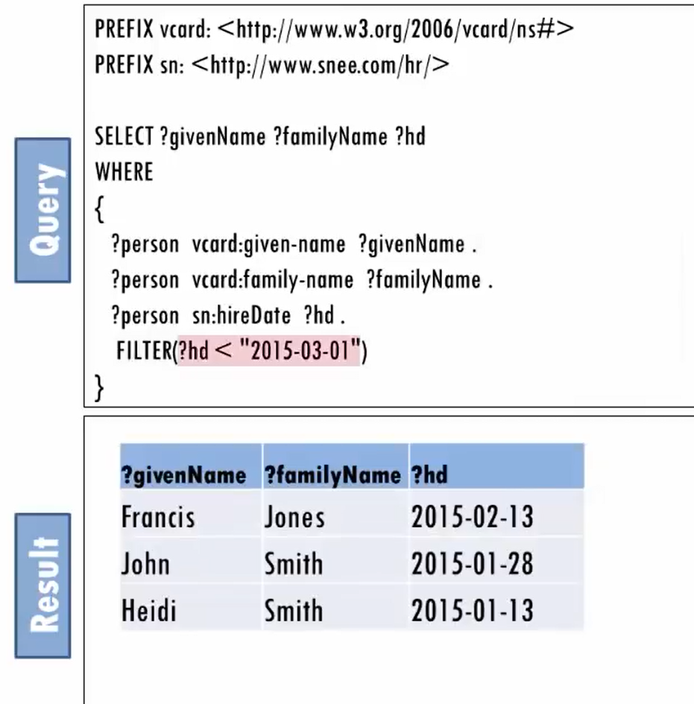
If we want to narrow down the results
based on some condition we can use a
filter pattern.
Say, we want a list of employees who are hired before March 1st ,
so the filter pattern specifies that we
only want HD values that are less than
March 1st 2015 expressed as an ISO 8601 date format.

Slide 52
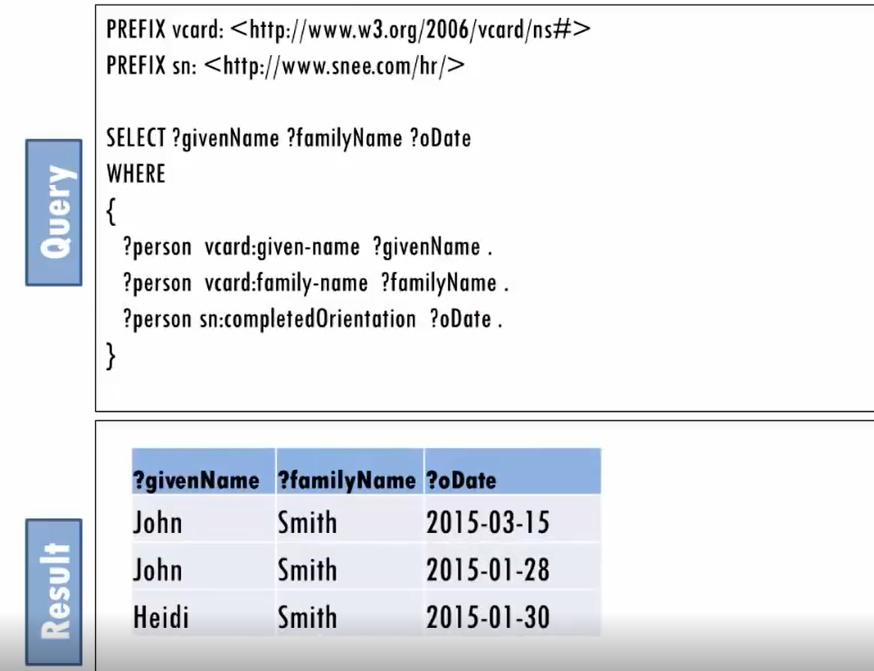
let's remove the
filter condition and list the employees and their completed orientation values instead of their hire date values.
Now we see Heidi and John's orientation dates but the other employees don't appear.
Notes:
Looking closely at the queries triple patterns, the query first looks for a triple with a given name value and then a triple with the same subject as the subject
that it found to match the first Triple pattern but with a family name value and then another triple with the same subject and a completed orientation value.

Slide 53
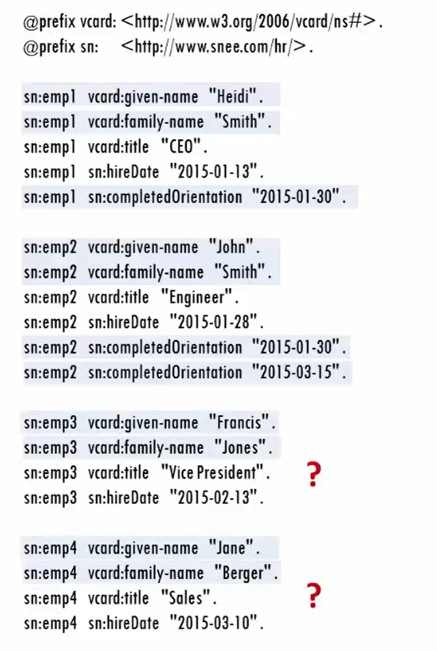
John and Heidi each have triples that match all the queries triple patterns but
Francis and Jane cannot match all three triple patterns

Slide 54
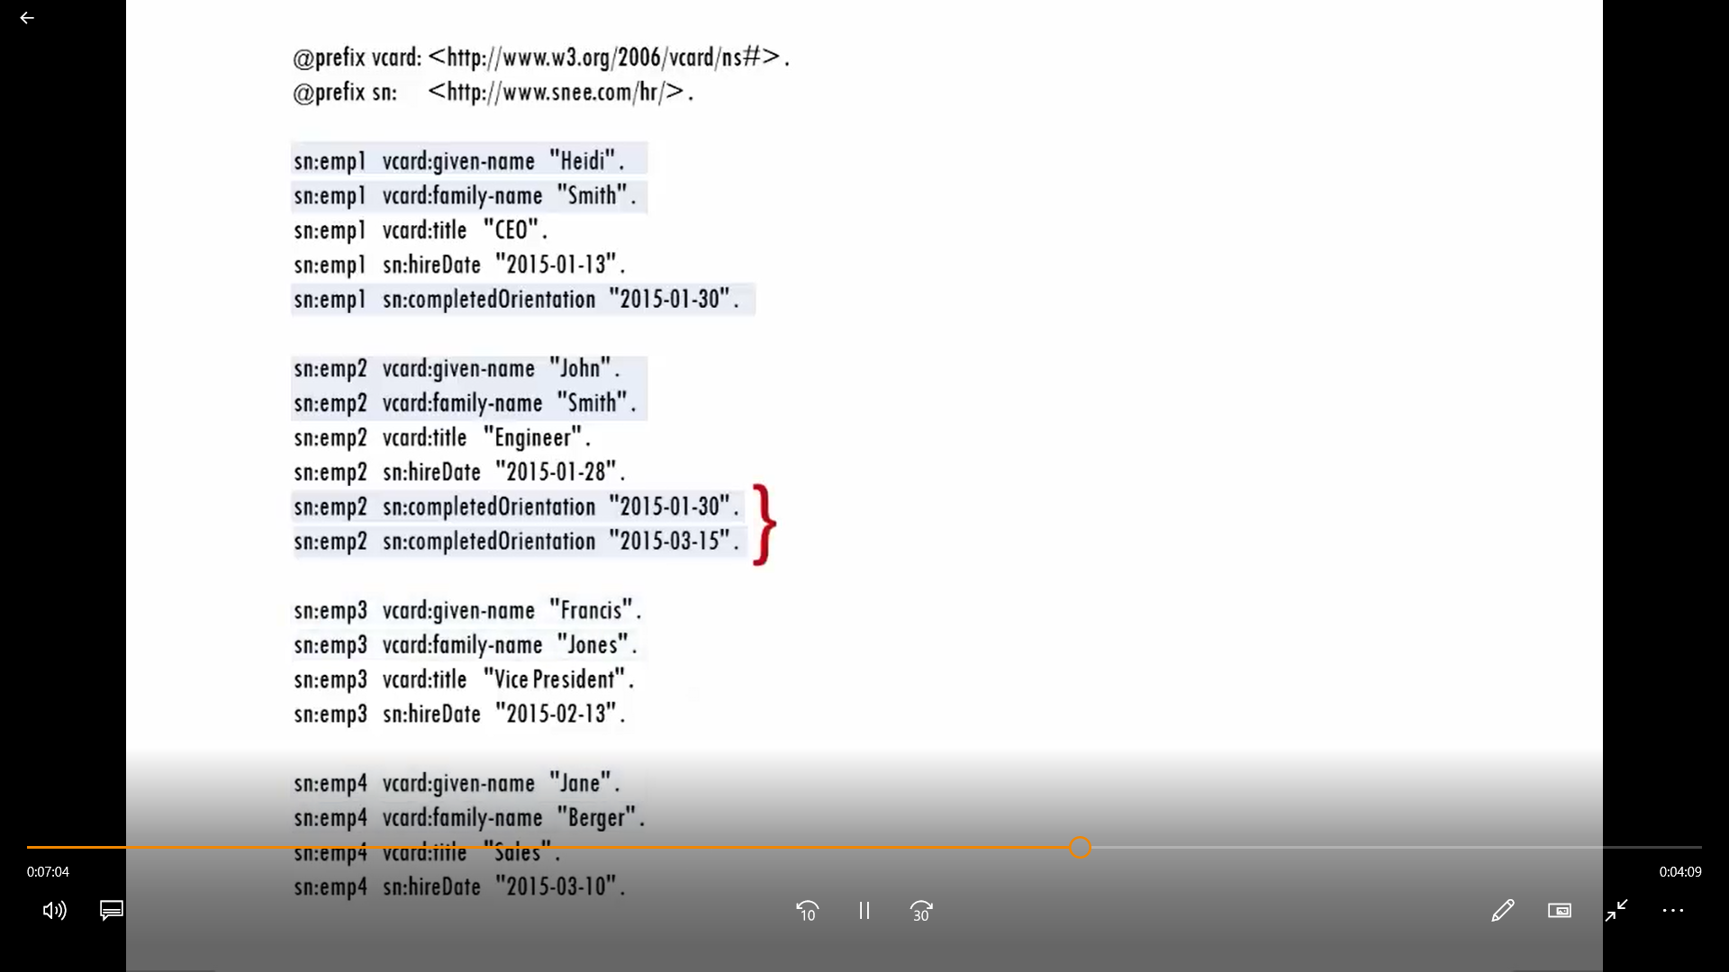
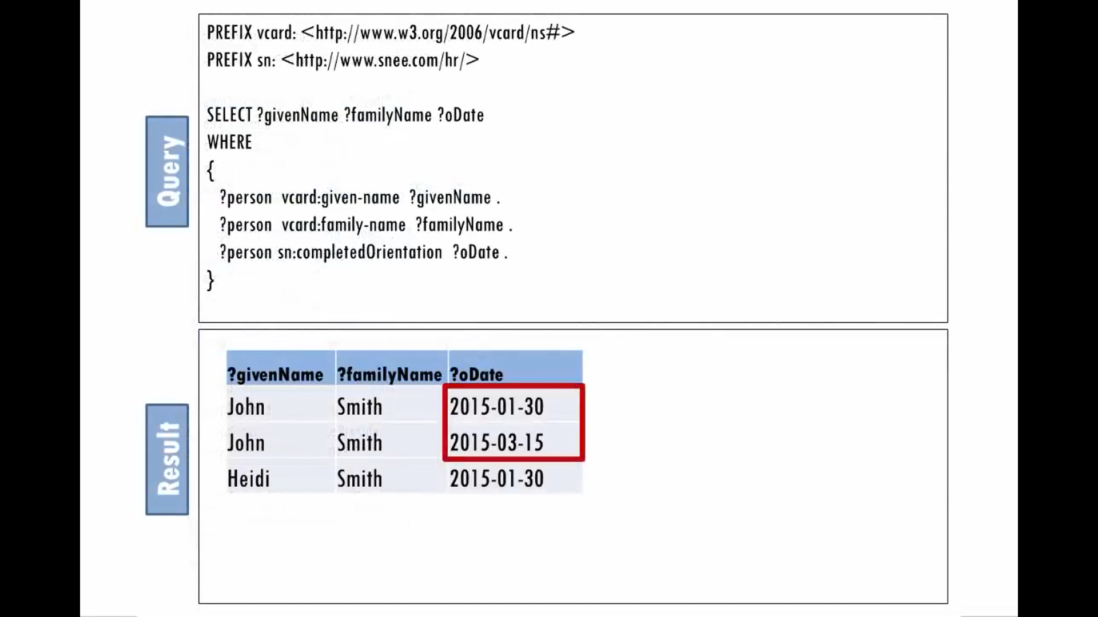
John actually had two triples that matched the queries third pattern which is why the query had two rows of results
for him one for each completed orientation value

Slide 55
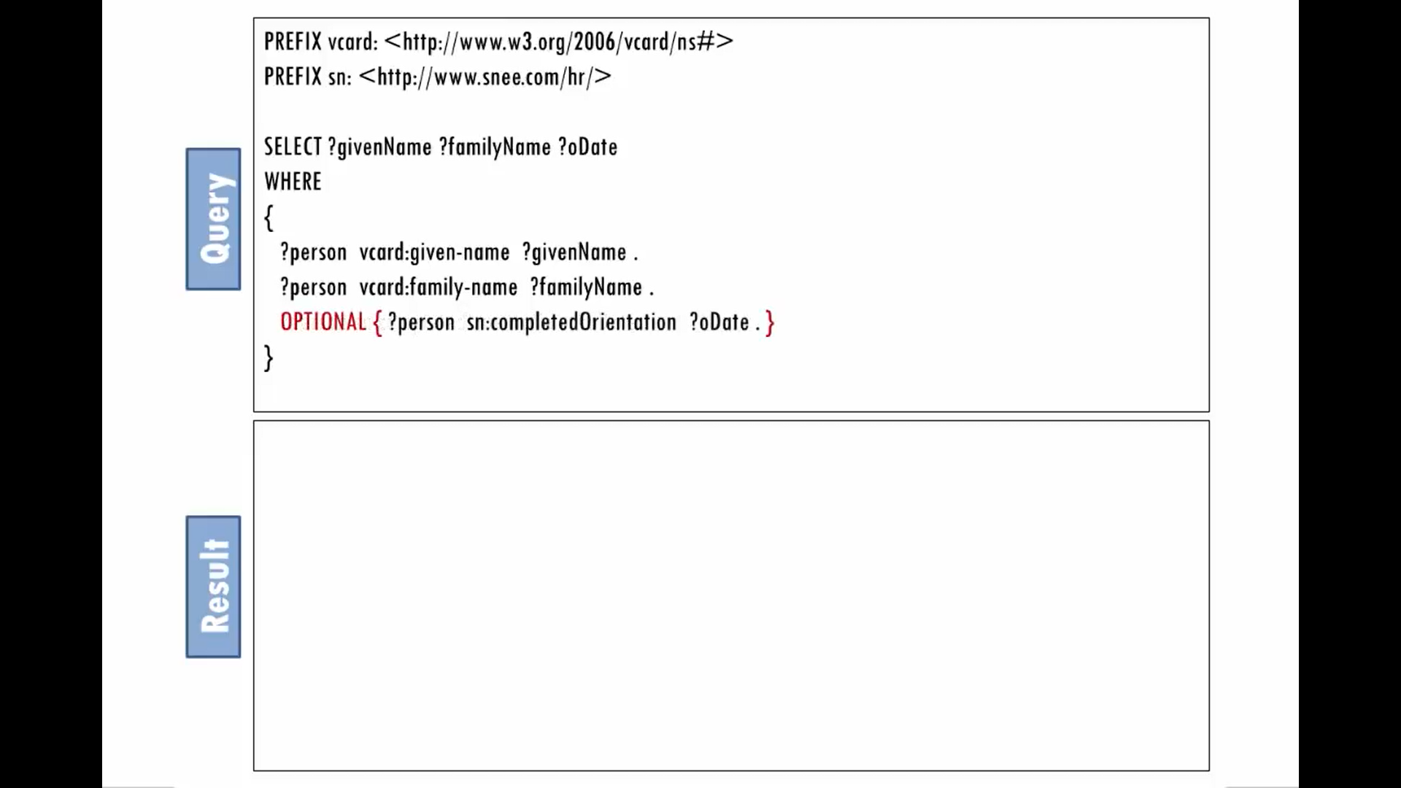

To list all of the employees and if they
have any their completed orientation
values.
Let matching on the third triple
pattern be optional ,this query asks for
everyone with a given name and a family name and if they have a completed orientation value.

Slide 56


let's say that Heidi is scheduling a new orientation meeting and wants to know who to invite or she
wants to list all employees who do not have a completed orientation value .
Her query asks for everyone's given and family name but only if for any employee who matches those first two triple patterns no triple exists that lists a completed orientation value for that employee.
Use keywords not exists and that shows ..

Slide 57


So far, we've seen to store a value in a variable is to include that variable in a triple pattern for the
query processor to match against some part of a triple.
We can use the bind keyword to store whatever we like in a variable this can be especially useful
when the bind expression uses values from other variables and calls some of SparQl's broad range of available functions to create a new value

Slide 58


In this query the bind statement uses sparkql’s concat function to concatenate the given name value stored by the first triple
pattern a space and the family name
value stored by the second triple
Pattern.
It stores the result of this concatenation in a new variable called full name. Running the query creates a
new full name value for each employee

Slide 59


A sparql construct query uses the same kind of where clauses that a select query can
use but it can use the values stored in
the variables to create new triples.
Note , how the triple pattern showing the
triple to construct is inside of curly
Braces.
Notes:
All the queries we've seen so far have been select queries which as with SQL ,lists values that you want returned as columns in a table of results.

Slide 60


These curly braces can enclose multiple triple patterns which is a common practice, when for example a construct query takes data conforming to one model and creates triples conforming to other models.
Good for Integration projects.

Slide 61

USING SPARQL TO INSERT TRIPLES
Notes:
let's use Sparkle the query language for RDF graphs to create a graph.
to write the sparkle query which creates an RDF graph perform these steps
first define prefixes to URIs with the prefix keyword .
In the example below we set bedrock as the default namespace for the query
next use insert data to signify you want to insert statements
write the subject predicate object statements finally
execute this query as you can see in the examples shown in the gray box we wrote
a query which included prefixed insert data and several subject predicate object statements which are
fred has spouse Wilma
fred has child pebbles Wilma has child
pebbles pebbles has spouse bamm-bamm and
pebbles has children Roxie and chip

Slide 62

USING SPARQL TO SELECT TRIPLES
Notes:
Now let's write a sparkle query to access the RDF graph you just created
first define prefixes URIs with the prefix keyword as in the earlier
example we set bedrock as the default namespace for the query next you select
to signify you want to select certain information and where to signify your
conditions restrictions and filters finally execute this query
as you can see in this example shown in the gray box we wrote a sparkle query which
included prefix select and where the red box displays the information which is
returned in response to the written query we can see that familial
relationships between Fred pebbles Wilma Roxie and chip Sparkle is quite similar
to sequel however unlike sequel which requires sequel schema and data in
sequel tables Sparkle can be used on graphs and does not need a schema to be
defined initially

Slide 63

USING SPARQL TO FIND FRED’S GRANDCHILDREN
Notes:
In the following example we will use sparkle to find Fred's grandchildren first we need to
establish whether fred has any grandchildren
first define prefixes to URIs with the prefix keyword next we use ask to
discover whether fred has a grandchild and where to signify the conditions as
you can see in the query in the green box
Fred's children's children are his grandchildren thus the query is easily written in
sparkle by matching Fred's children and then matching his children's children
the ask query returns yes so we know fred has grandchildren

Slide 64

USING SPARQL TO FIND FRED’S GRANDCHILDREN
Notes:
Now that we know fred has at least one grandchild how do we find who are Fred's grandchildren
that is what are their names
this question is easily answered by using the same query from the previous slide and replacing the ask statement
with a select statement first define prefixes to URIs with the prefix keyword then we use select to signify
that we want to select a grandchild and where to signify our conditions the
query results reflected in the red box tell us that Fred's grandchildren are Roxy and chip

Slide 65

Notes:
You can use data types and language tags.
You can sort and aggregate query results and you can add delete and update data.
You can also retrieve JSON XML and delimited versions of query results from query processors
and you can send queries to remote private or public data collections.

Slide 66

Notes:
URL of course it stands for Uniform Resource locator and this is a typical URL where we have the server name and maybe a
directory number and then a file name that we want to reach so if we put this into our web browser then what we're
doing is we're accessing the server which is located here this is just the textual representation
otherwise we have the IP address .
now we have Uniform Resource locators and also we have universal resource names these were used for example to identify book
so for example to first identify a certain book we can use an urn or URL ISBN and we give the book number
URI a universal resource identifier which actually encompasses these two so the sort of the root of the tree is a URI .
URL is a subset or sort of a branch over URI ,every URL is a URI but not every URI is a URL
most of them are URLs but they're not all URLs and maybe that's why because most of them most of

Slide 67


Slide 68


Slide 69


Slide 70



Slide 71


Slide 72


Slide 73


Slide 74


Slide 75


Slide 76
Querying Data

Slide 77


Slide 78


Slide 79


Slide 80


Slide 81


Slide 82


Slide 83


Slide 84


Slide 85


Slide 86


Slide 87


Slide 88


Slide 89


Slide 90


Slide 91


Slide 92


Slide 93


Slide 94


